Slide 1
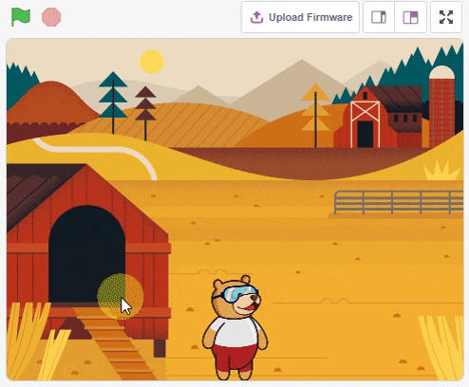
Animating a Sprite

Slide 2
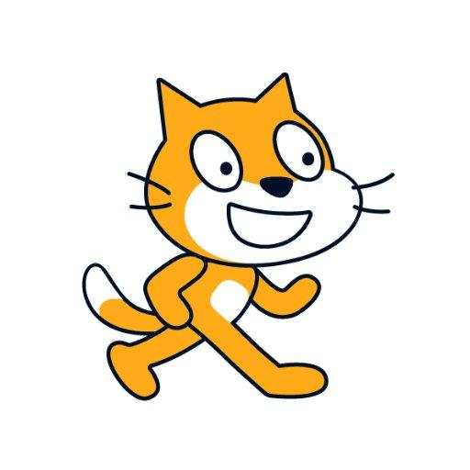
What is Scratch?

Slide 3
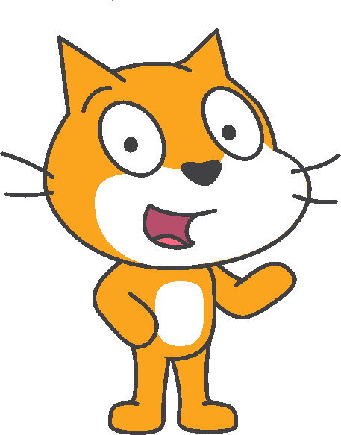
What is Scratch?
Scratch is a free visual programming language developed to help simplify the process of creating and programming animations, games, music, interactive stories and more.

Slide 4
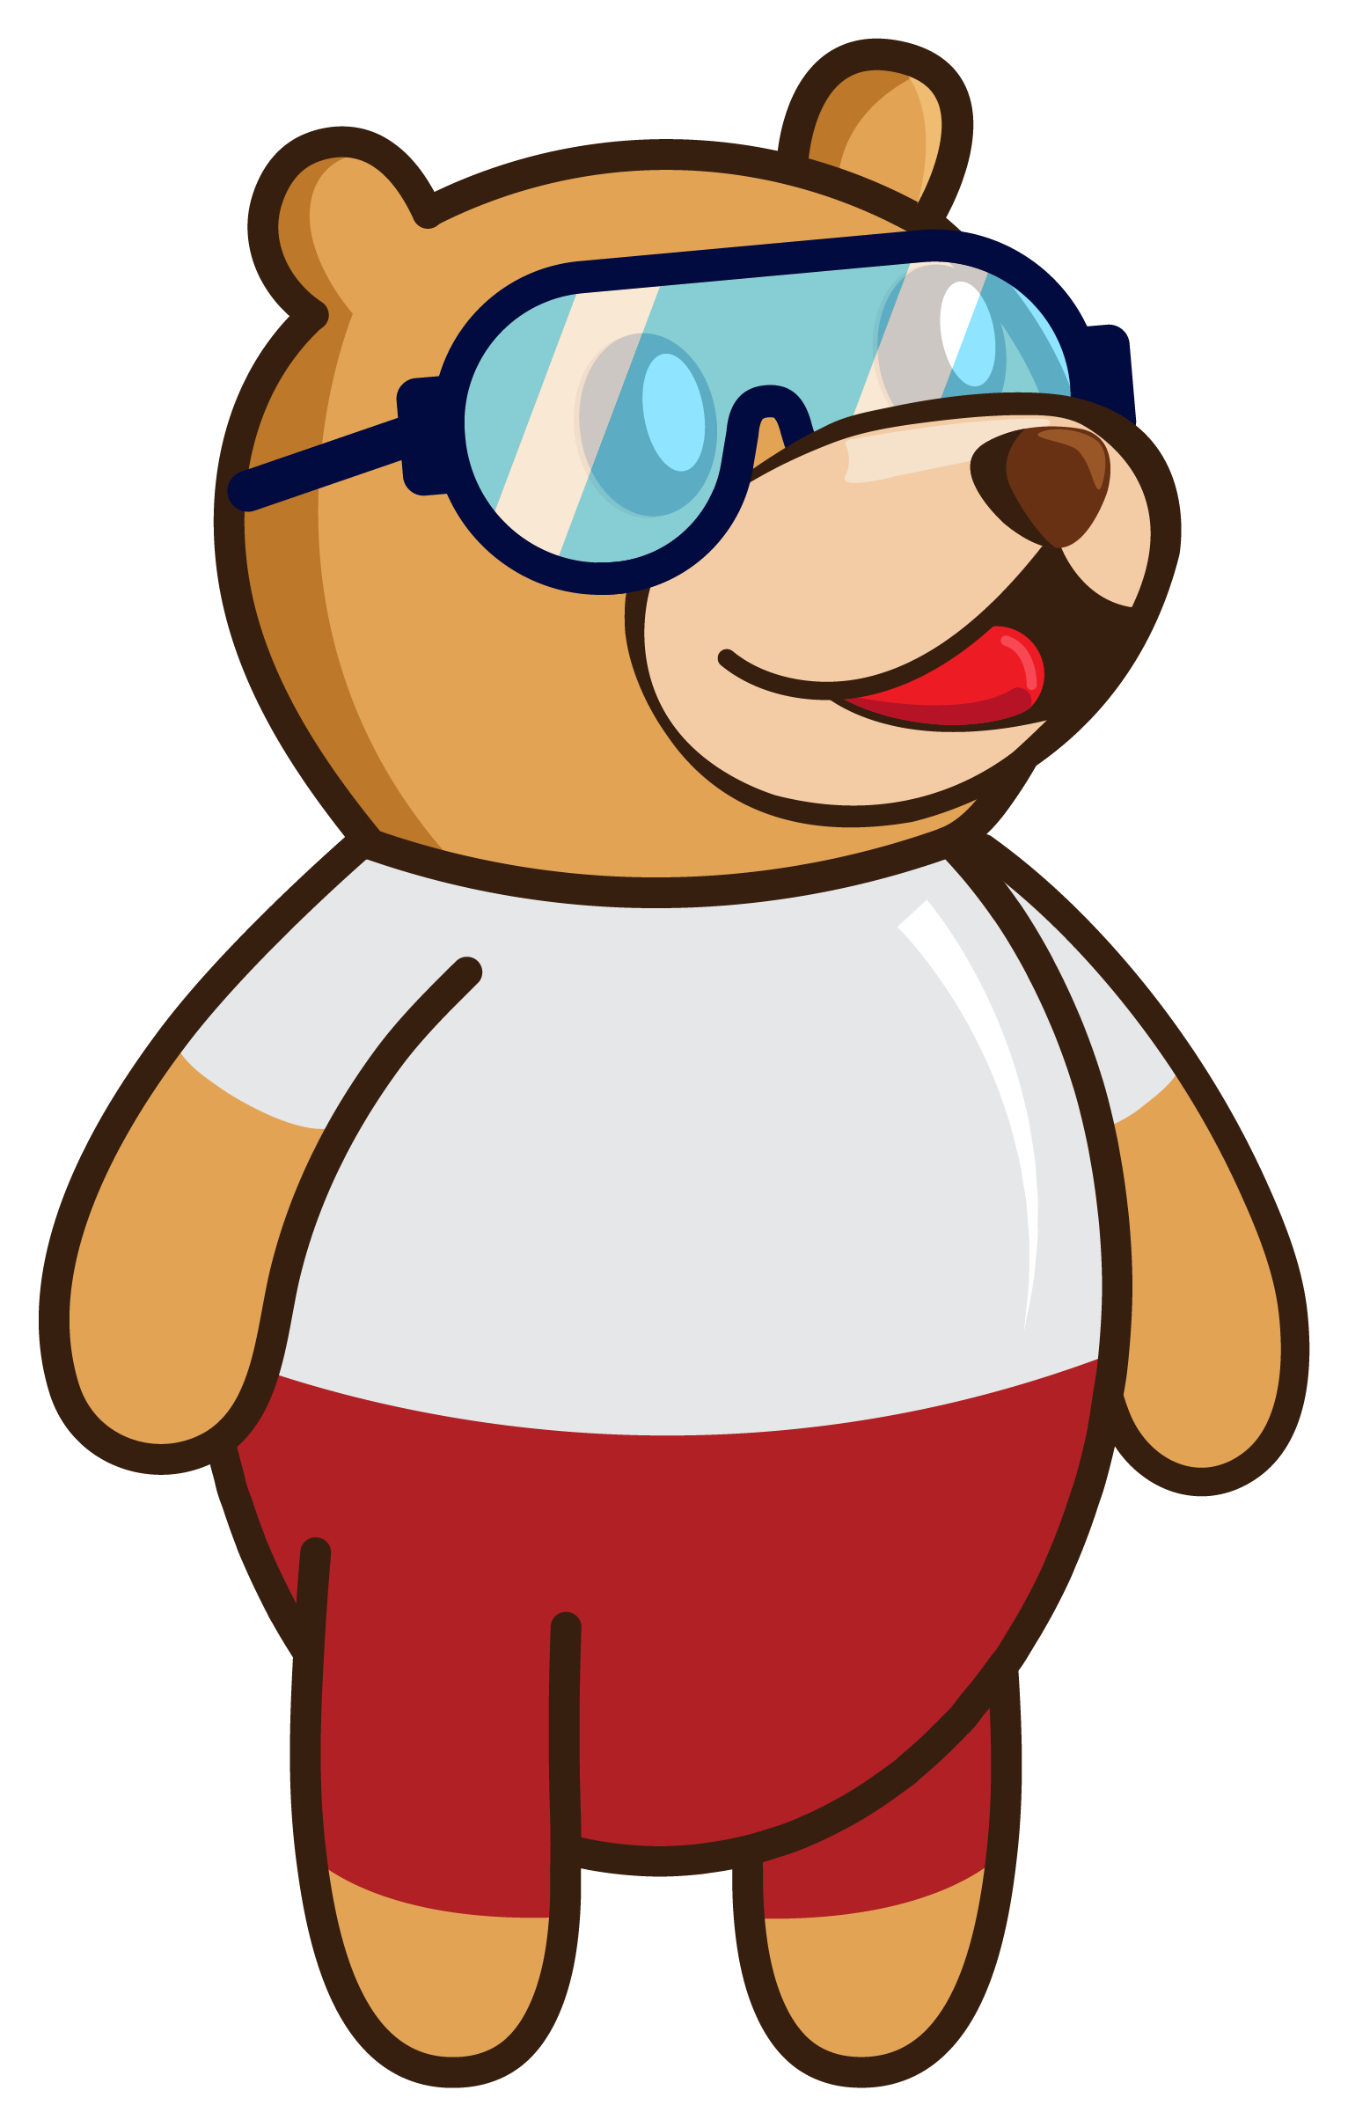
What is PictoBlox?

Slide 5
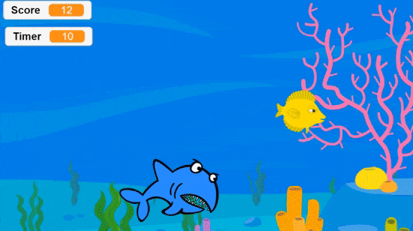
What is PictoBlox?
PictoBlox is a programming software based on Scratch, where you can make interactive games, animations or program robots and projects.

Slide 6
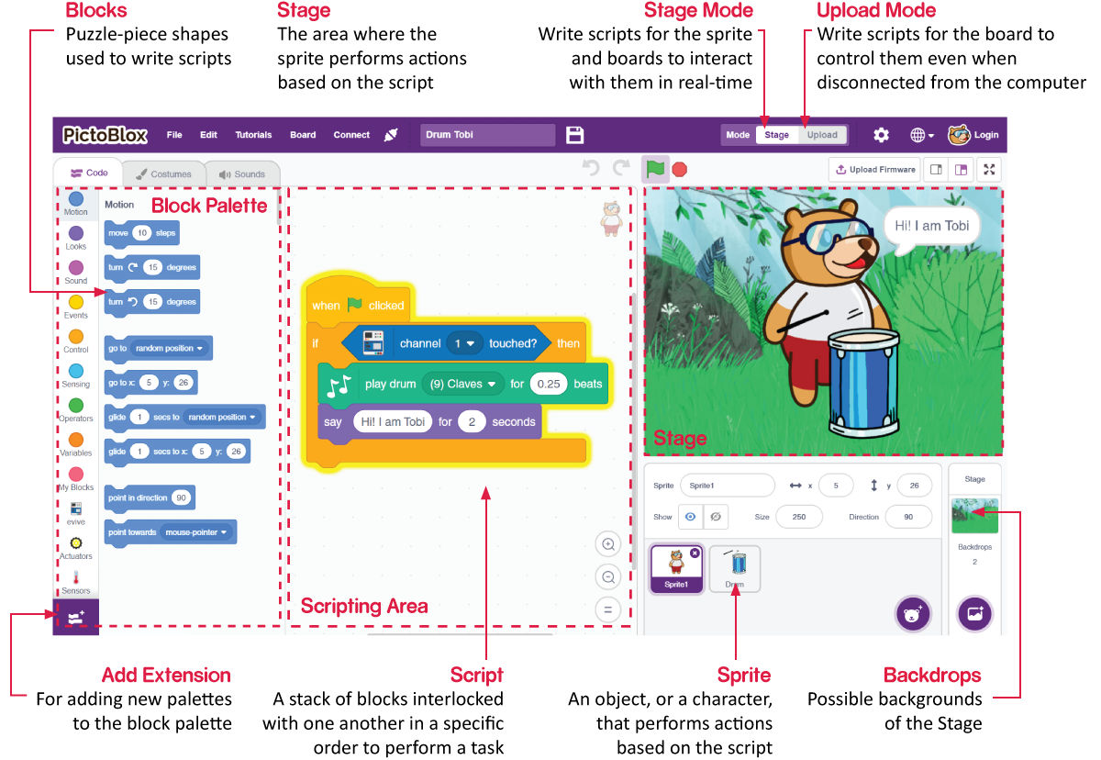
PictoBlox Interface

Slide 7
Animating a Sprite
In this Activity, First We will learn how to add a backdrop and a sprite on the Stage and then create a small animation of Tobi moving around on the stage.

Slide 8
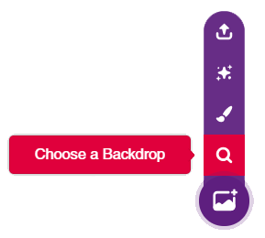
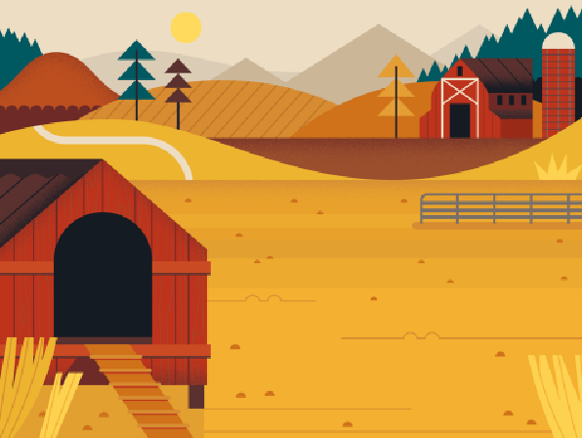
STEP 1: Choose a backdrop
Click on choose a backdrop button.
Choose “Farm” as backdrop from library.

Slide 9
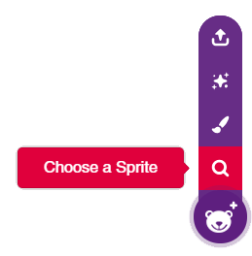
STEP 2: Choose a Sprite
We can choose sprite from choose a sprite button.
“Tobi” sprite is already selected. Let’s animate it

Slide 10
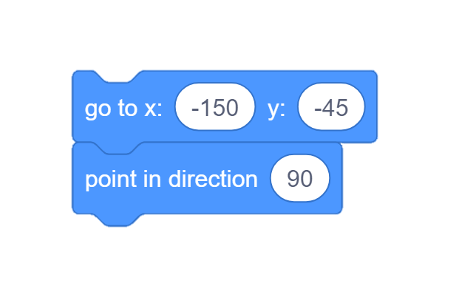
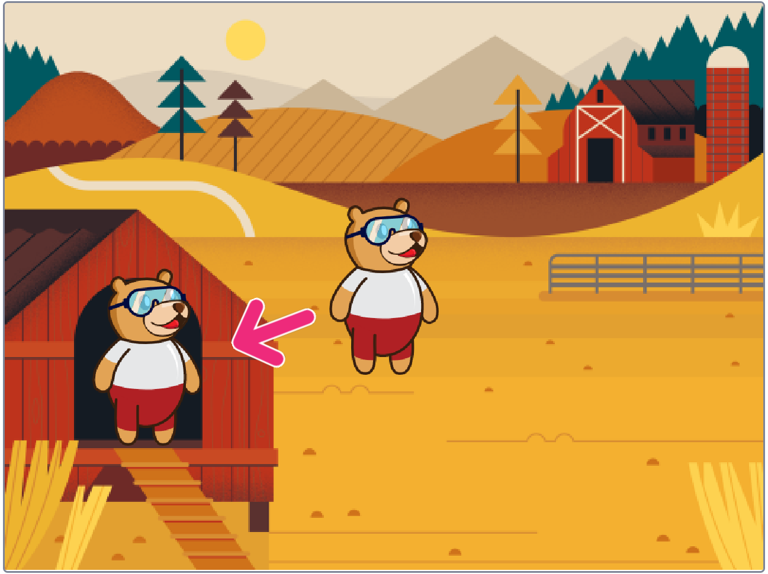
STEP 3: Set the Starting Point
Using following blocks from motion palette, we will set the starting position of Tobi.

Slide 11
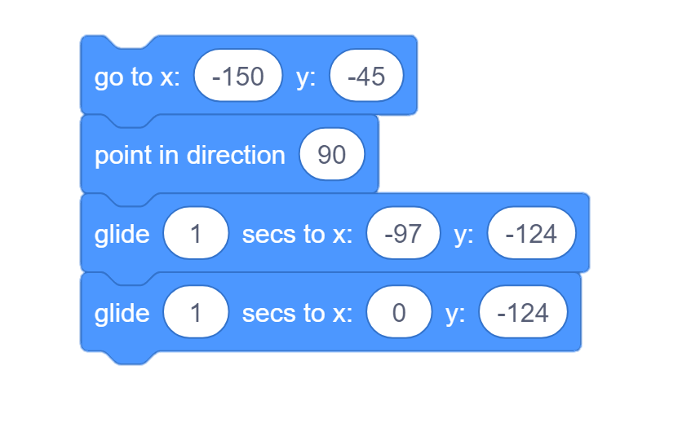
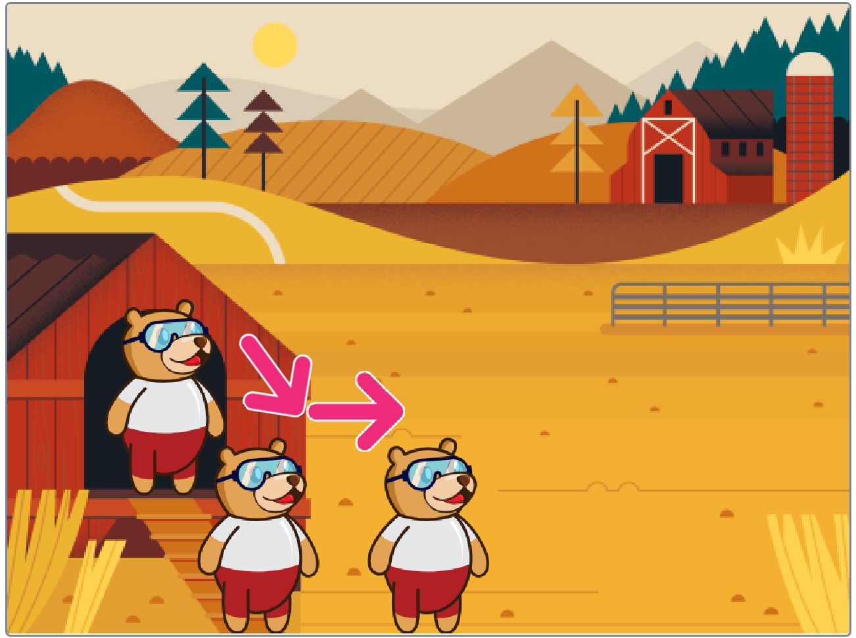
STEP 4: Glide to other Points
Using following blocks from motion palette, we will make Tobi glide to the other points.

Slide 12
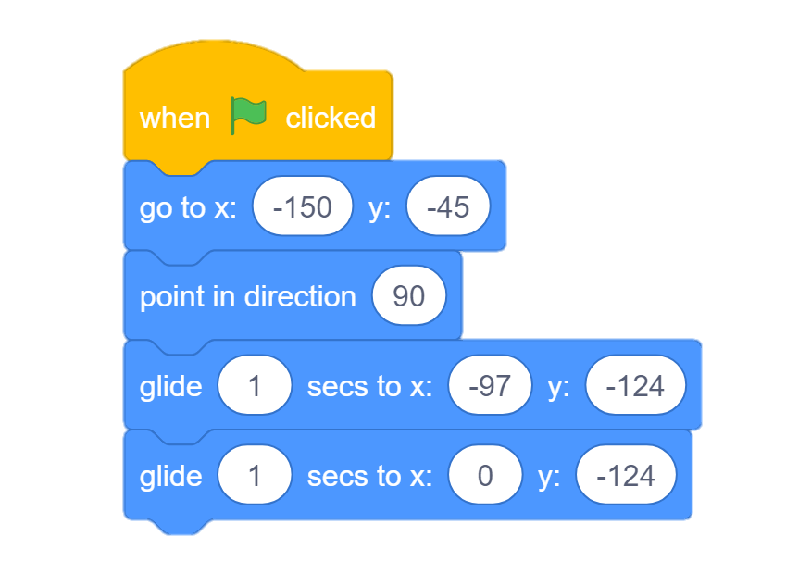
STEP 5: Add a Hat Block
From events palette, we will add a hat block, now, we can control our animation just by clicking on the green flag button over stage area.

Slide 13
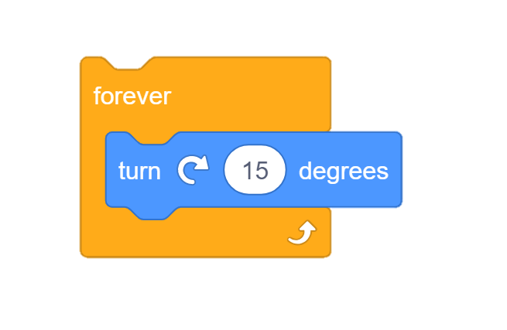
STEP 6: Make Tobi Rotate
Let’s make small another script to make Tobi rotate.
We will use turn block from motion palette and forever block from control palette.

Slide 14
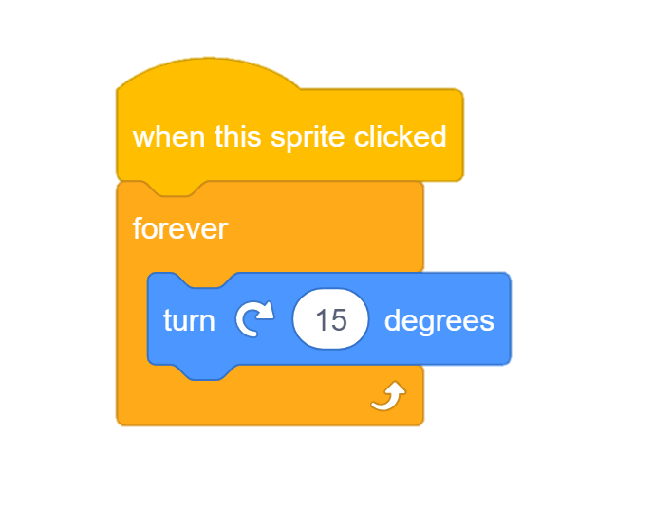
STEP 7: Add a Hat Block
Let’s add a hat on this script too.
This hat will sense whenever we click on Tobi and make it rotate.

Slide 15
STEP 8: Let’s Play
Maximize the stage and make it move & rotate.

