Slide 1
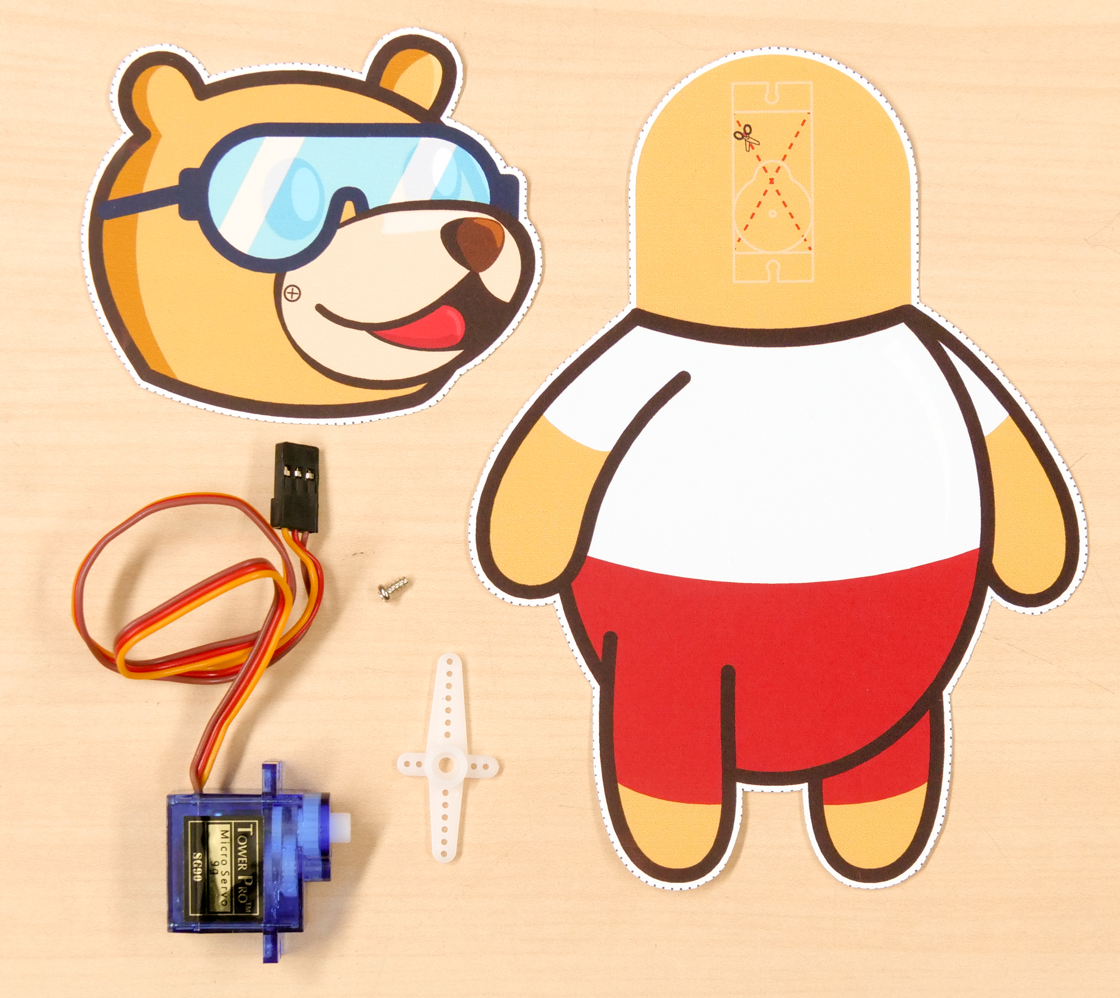
Tobi’s Head Moves

Slide 2
Tobi’s Head Moves
In this Activity, First We will understand how Servo motor works and then control the movement of Tobi's head using the servo motor.

Slide 3
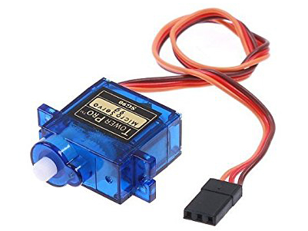
What is Servo Motor?

Slide 4
The need for a Servo Motor
DC Motors rotates in 360 and you can control the speed and the direction of motor.
But what if you want to move the motor at an angle?
There is no way you can do precisely using DC motor.
In servo motor you can control the angle with precision.

Slide 5
Servo Motor
A servo motor is a device that is used to rotate or push parts of a machine to which it is rotating with precision.
Unlike DC motors, they generally rotate to an angle and then stop.

Slide 6
Controlling
Servo Motor

Slide 7
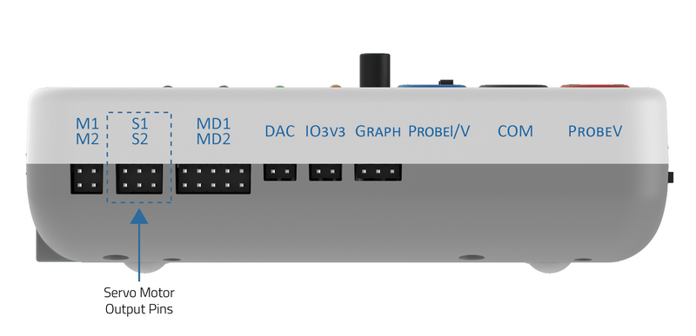
Controlling a Servo Motor using evive
You can control 2 Servo Motors directly with evive using Menu.

Slide 8
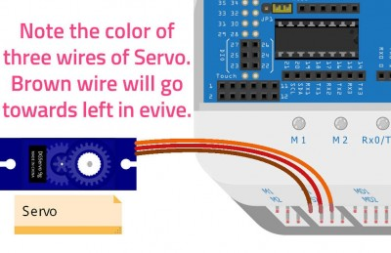
Controlling a Servo Motor using evive
Take the servo motor and insert the wires attached to it in the first servo motor channel, i.e. S1.

Slide 9
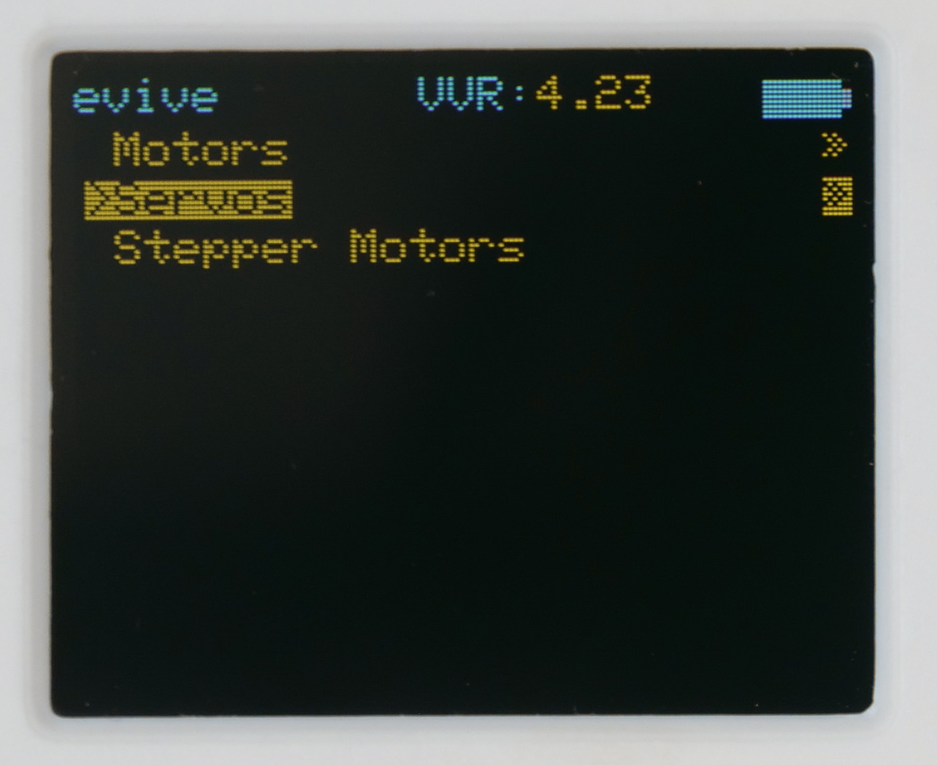
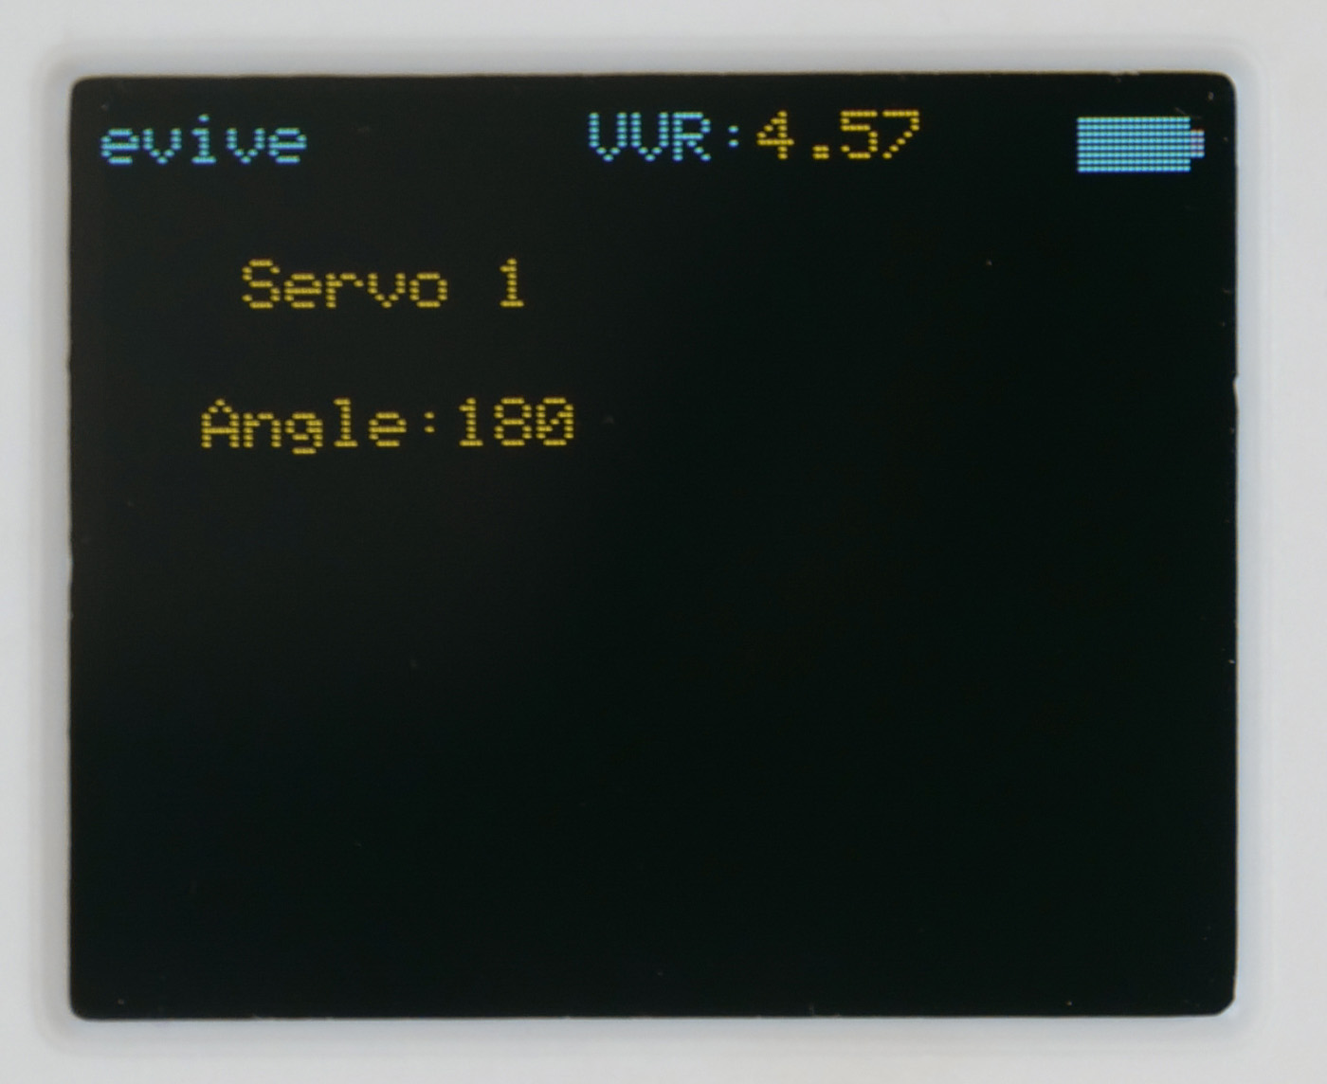
Controlling a Servo Motor using evive
Switch on your evive.
Navigate to Controls > Servos > Servo 1

Slide 10
Controlling a Servo Motor using evive
The angle can be controlled/changed using the potentiometer knob.
On rotating the knob, you’ll observe that the minimum the angle can go is 0° and the maximum is 180°.

Slide 11
Activity: Tobi’s Head Moves

Slide 12
Tobi’s Head Moves
In this activity, we’re going to move the head of a cutout of our learning buddy, Tobi with the help of a servo motor.
We will fit the servo motor in the cutout of Tobi’s head and control its movement using evive’s potentiometer.
Let's begin!

Slide 13
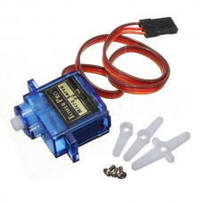
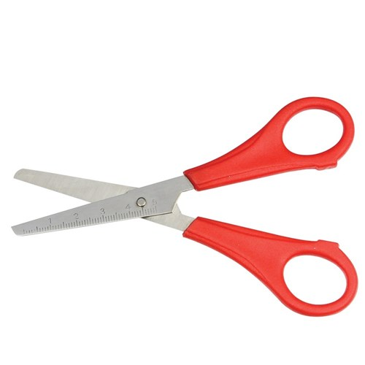
Components Required
evive
Tobi’s cut out
Servo motor with accessories
Scissors

Slide 14
STEP 1: Take cutouts
Cut out Tobi’s head and body using a pair of scissors.

Slide 15
STEP 2: Cut and fold
On the cutout of Tobi’s body, there is a space marked for the servo motor.
Cut and fold the flaps inwards to make support for the servo motor.

Slide 16
STEP 3: Install the Servo
Insert the servo motor in the slot made on the cutout of Tobi’s body.
Note the position of servo head.

Slide 17
STEP 4: Attach the Servo head
Attach the servo head that comes with the servo accessories to the servo motor.

Slide 18
STEP 5: Attach Tobi’s Head
Take the cutout of Tobi’s head and fix it onto the servo head using a tiny screw provided with the servo.

Slide 19
STEP 6: Connect the motor
Take the servo motor and insert the wires attached to it in the first servo motor channel, i.e. S1.

Slide 20
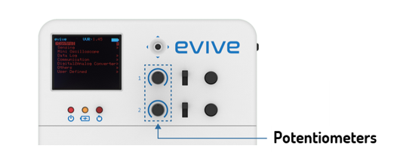
STEP 7: Controlling the Head
Switch on your evive.
Navigate to Controls > Servos > Servo 1
Control the Tobi’s head using the potentiometer knob 1.

