Slide 1
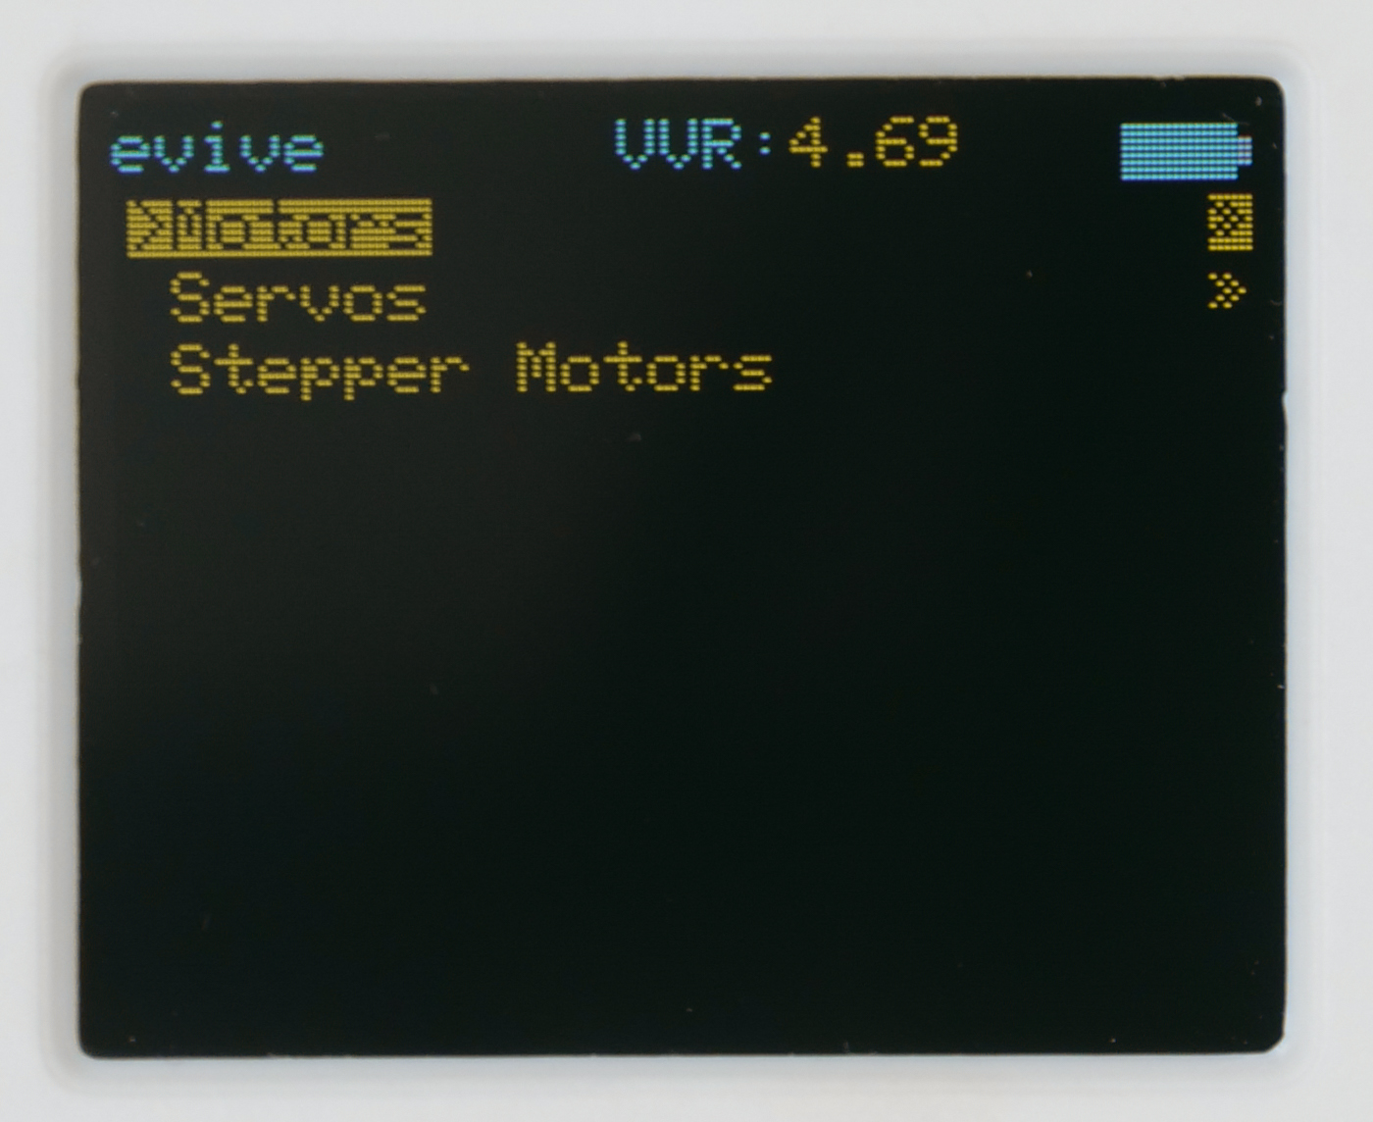
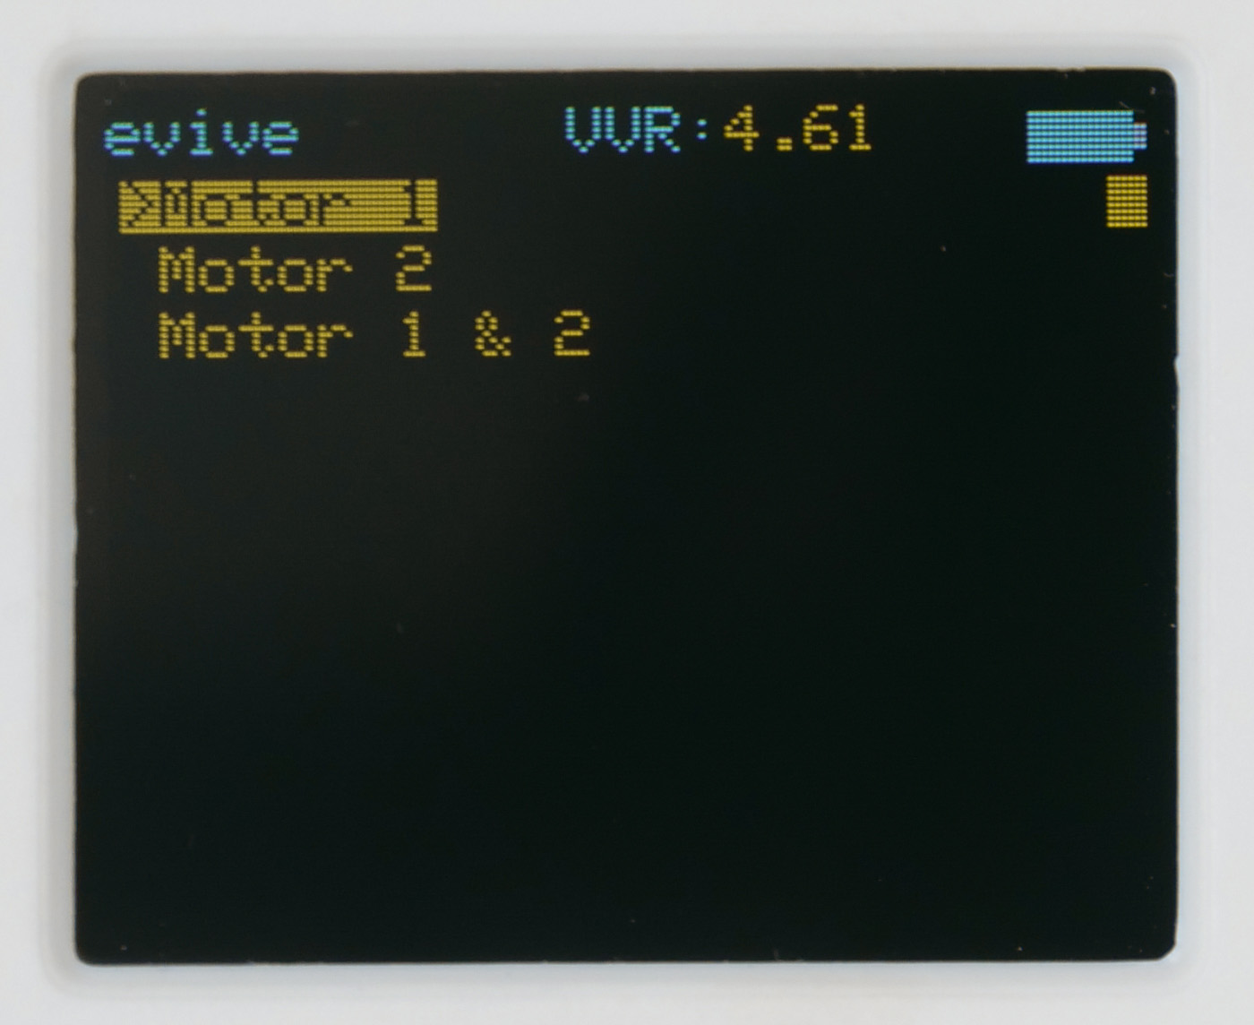
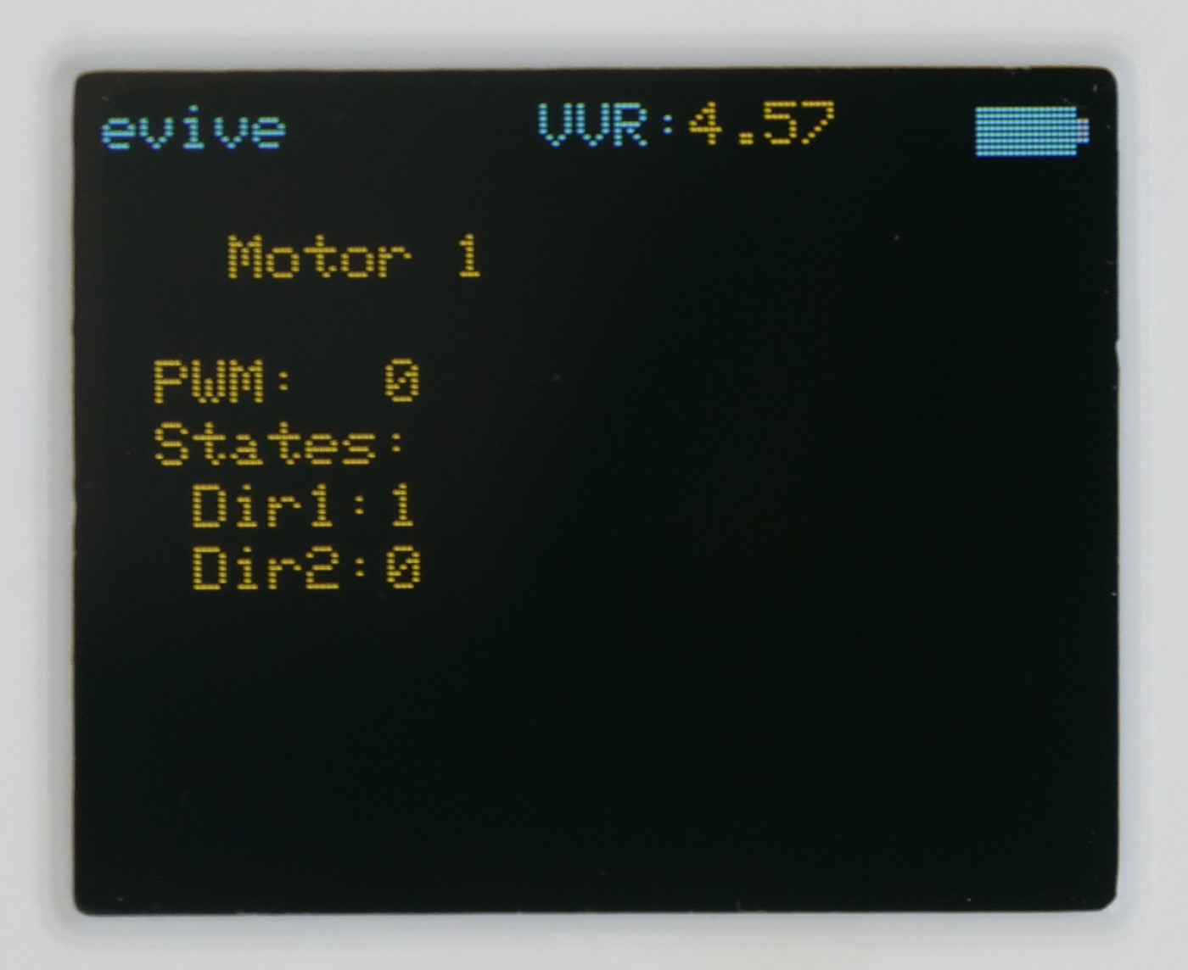
1.3 Mini Fan
In this Activity, First We will understand how DC motor works and then control the movement of a mini man using the dc motor , potentiometer and slide switch of evive.
evive, Dc motor, Fan’s cutout
STEP 1:
Cut out Fan’s blade and body using a pair of scissors.
STEP 2:
Cut and Make the spaces for motor shaft and wires.
STEP 3:
Fold the fan’s body. Fit a DC motor inside it and Glue the open as shown in figure.
STEP 4:
Carefully fit the fan blade on the motor shaft.
STEP 5:
Insert the motor wires in the first motor channel, i.e. M1.
STEP 6:
Switch on your evive, Navigate to
Controls > Motors > Motor 1
And control the Fan speed using the potentiometer knob 1 and direction of rotation using slide switch 1.

