Slide 1
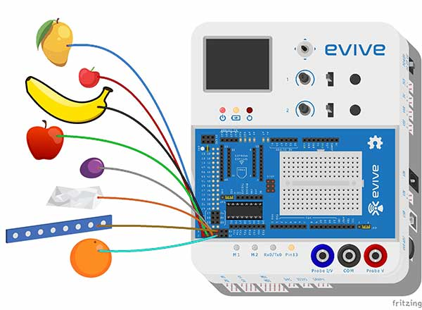
Touch Piano

Slide 2
Touch Piano
In this Activity, First We will understand how touch sensor works and then make a touch piano using evive capacitive touch sensors.

Slide 3
How Touch Sensors Work?

Slide 4
Touch Sensors
Capacitive touch sensors are sensitive to charge. They monitor the charge level of the object and tell the evive.
So if you have an object which has 5 free charges, then it will tell evive 5 charges.

Slide 5
Touch Sensors
But when another conductor touches the object, the number of free charge increases on the channel.
So now there are 10 charges. This change in free charge is detected in touch sensor.
However this only work for conductors and not for insulators. Because no free charge is there.

Slide 6
Activity: Touch Piano

Slide 7
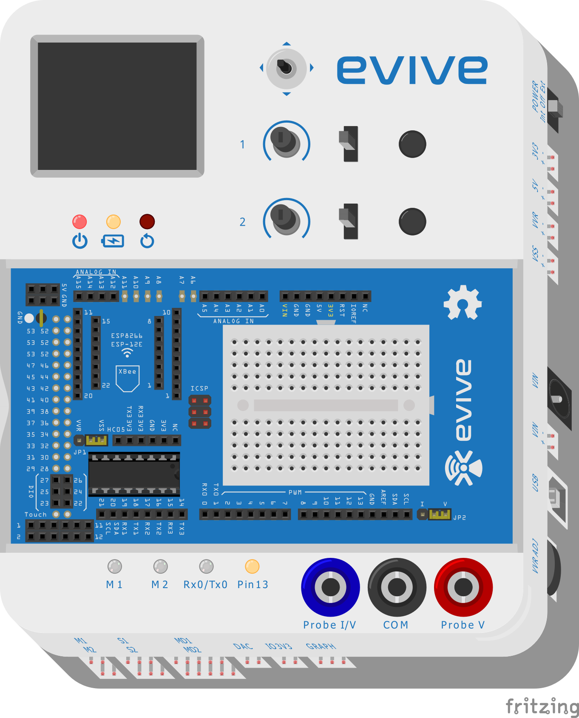
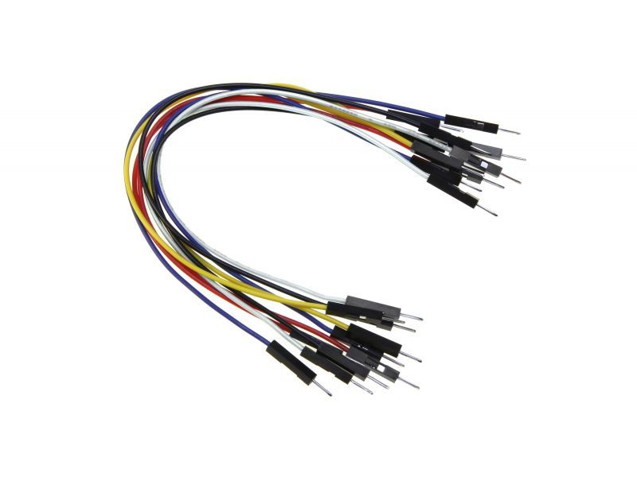
Components Required
evive
Male to Male Jumper wires
6-8 Fruits

Slide 8
STEP 1: Make the Connections
Connect different conductive objects around you to touch sensors using jumper wires/Alligator clips.

Slide 9
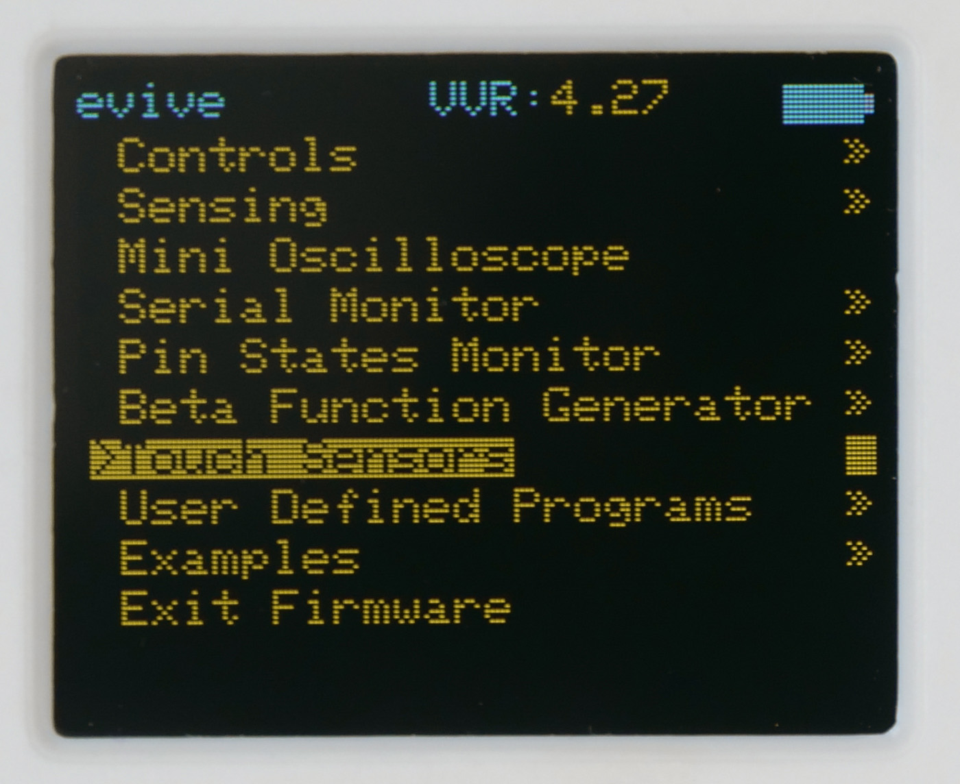
STEP 2: Navigate to Touch Sensor
Switch ON evive.
Inside evive’s menu, navigate to touch sensors using navigation key.
Don’t touch the objects while navigating to touch sensors.

Slide 10
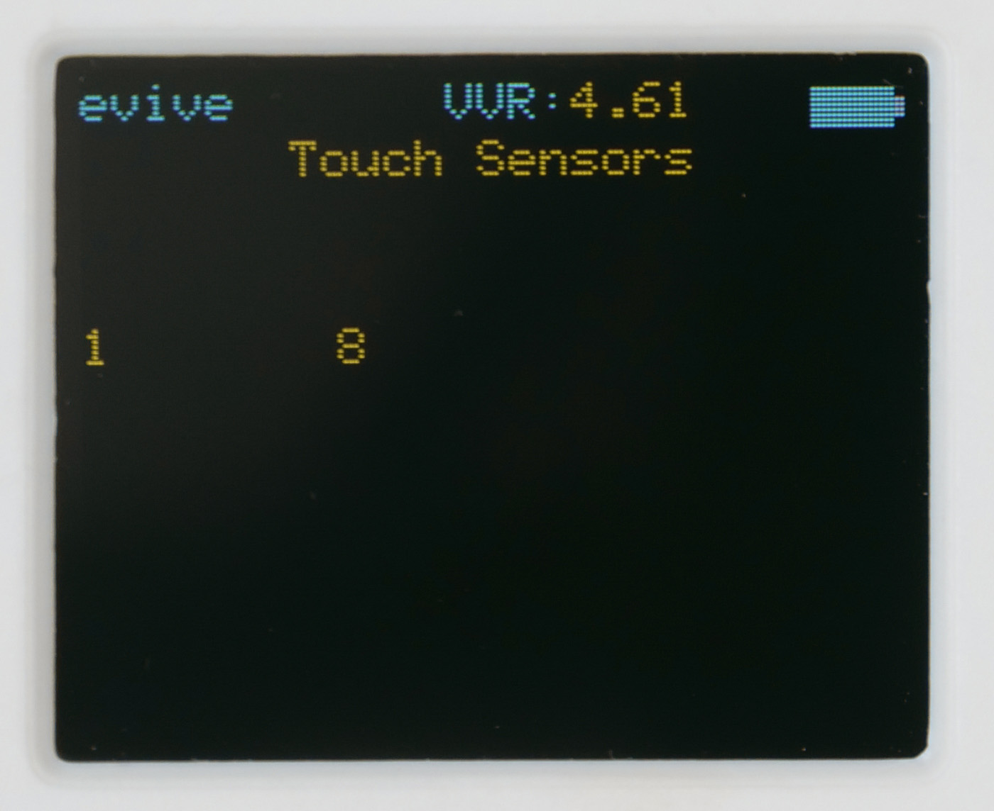
STEP 3: Let’s Play
Now, one by touch the objects.
Every object will respond with a respective tone.

