Slide 1
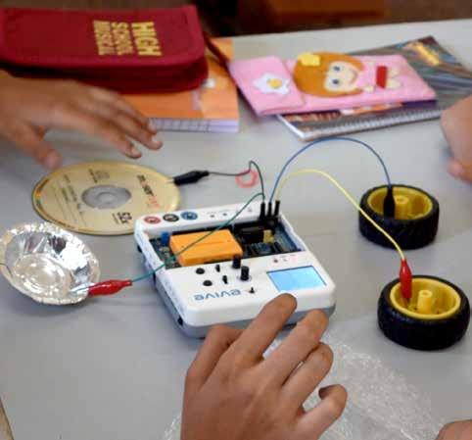
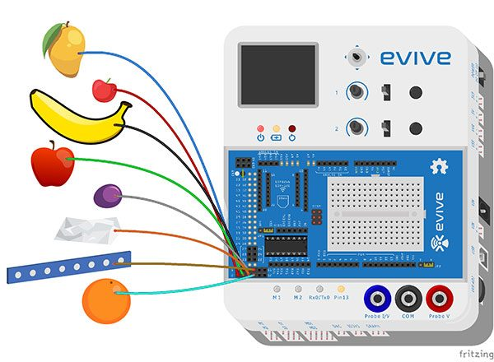
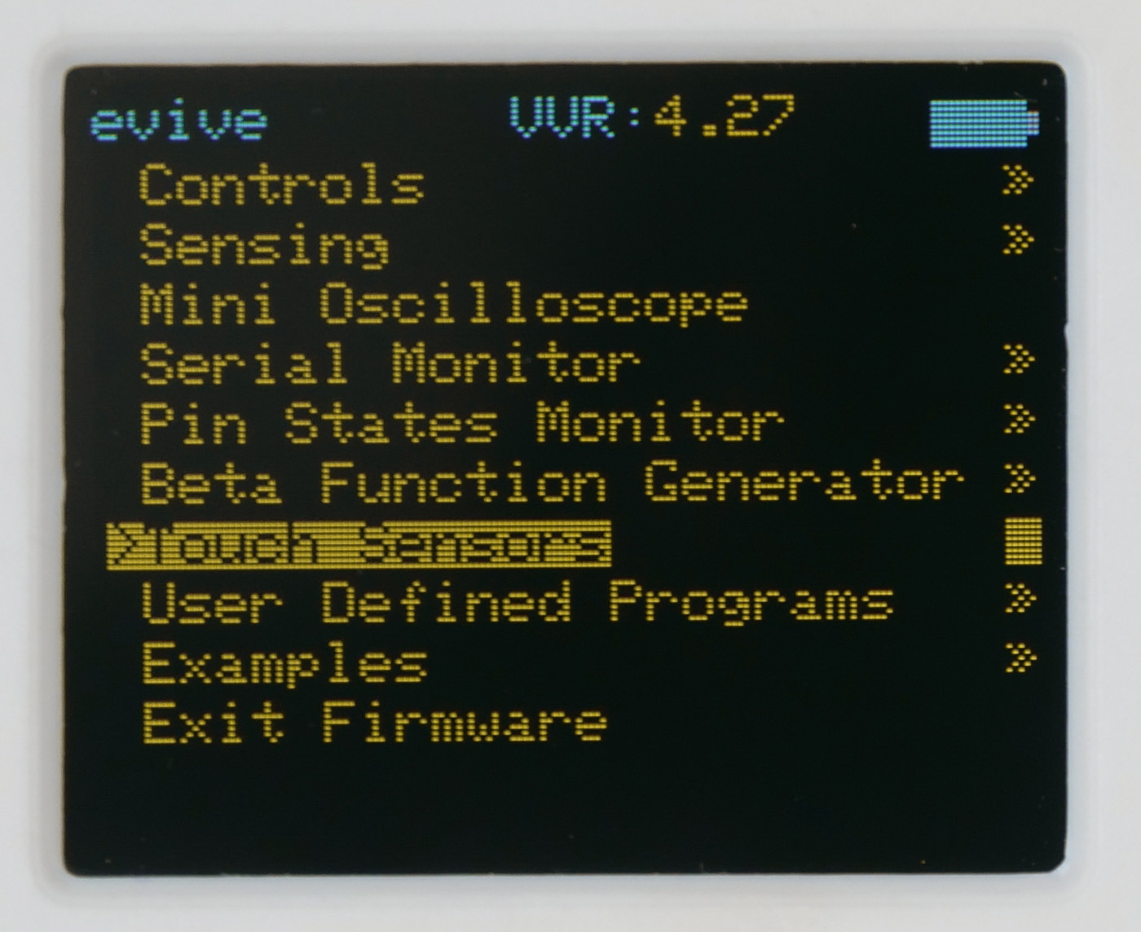
1.1 Conductors & Insulators
In this Activity, First We will learn about conductors and insulators and then classify different objects into conductors and insulators using evive capacitive touch sensors.
evive, jumper cables, 4-5 Objects
STEP 1:
Connect different objects around you to touch sensors using jumper wires/Alligator clips.
STEP 2:
Inside evive’s menu, navigate to touch sensors using navigation key.
STEP 3:
Now, one by touch the objects and identify whether it’s a conductor or an insulator.
OBSERVATION TABLE
S. No. | Name of the Object | Conductor/Insulator
Which material is the best conductor of electricity?
. . . . . . . . . . . . . . . . . . . . . . . . . . . . . . . . . . . . . . . . . . . . . . . . . . . . . . . . . . . . . . . . . . . . . . . . . . . . . . . . . . . . . . . . . . . . . . . . . . . . . . . . . . . . . . . . . . . . . . . . . . . . . . . . . . . . . . . . . . . . . . . . . . . . . . . . . . . . . .

