Slide 1
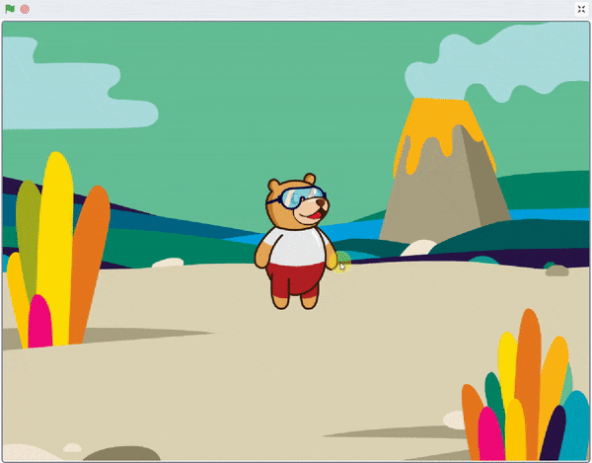
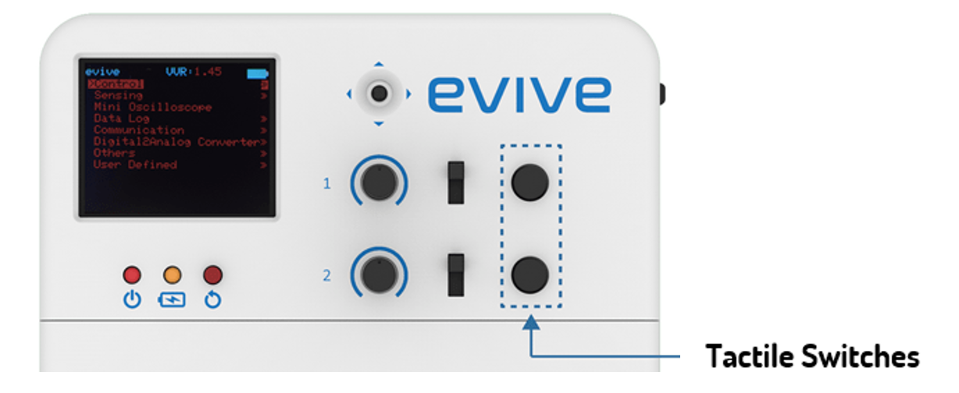
Jumping Tobi

Slide 2
Interfacing evive with PictoBlox

Slide 3
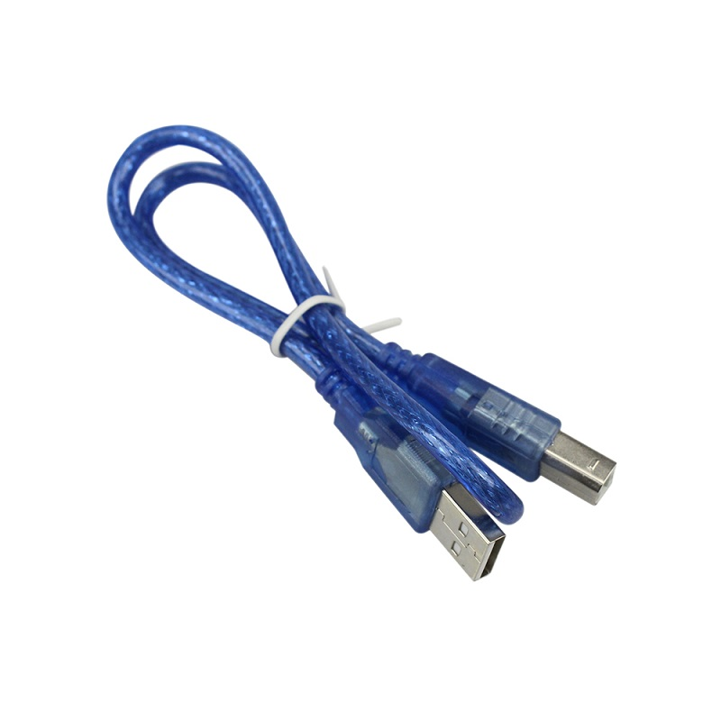
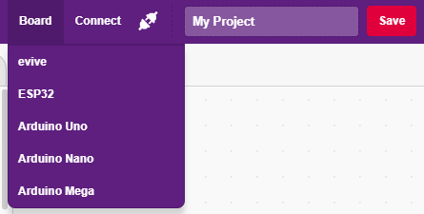
Interfacing evive with PictoBlox
Connect evive to your laptop/PC via USB cable and open PictoBlox.
In PictoBlox, go to the menu and click on the Boards Select the evive.

Slide 4
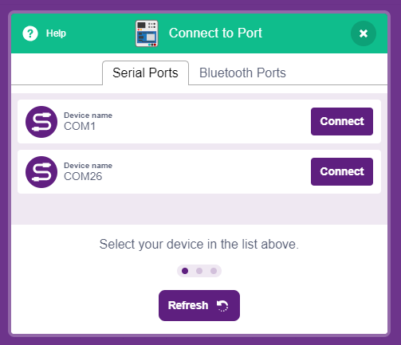
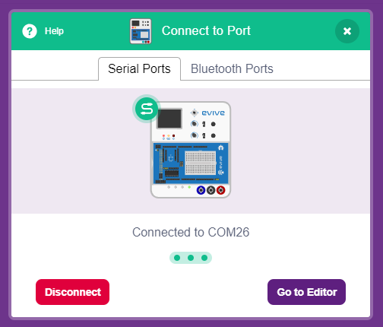
Interfacing evive with PictoBlox
Once you’ve selected the board, click on the Connect tab and connect the board.

Slide 5
What is Stage Mode?

Slide 6
Stage Mode
In this mode, you can write scripts for the sprite and boards like evive to interact with sprites in real-time.
If you disconnect the board with PictoBlox, you cannot interact with the board anymore. In this mode, you can make games and animation interacting with evive.

Slide 7
Upload Firmware
You have to upload the firmware into the device before interacting with it.
Click on Upload Firmware button.
Once you successfully uploaded the firmware you will see evive logo on evive display.

Slide 8
Jumping Tobi
In this Activity, First We will learn how to interface evive with Pictoblox and then create an animation of jumping Tobi i.e. Tobi will jump whenever you press tactile switch on evive.

Slide 9
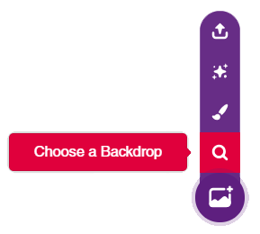
STEP 1: Choose a backdrop
Click on choose a backdrop button.
Choose “Jurassic” as backdrop from library.

Slide 10
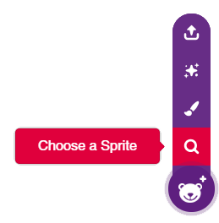
STEP 2: Choose a Sprite
We can choose sprite from choose a sprite button.
“Tobi” sprite is already selected. Let’s animate it.

Slide 11
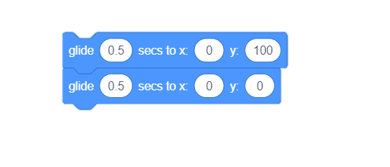
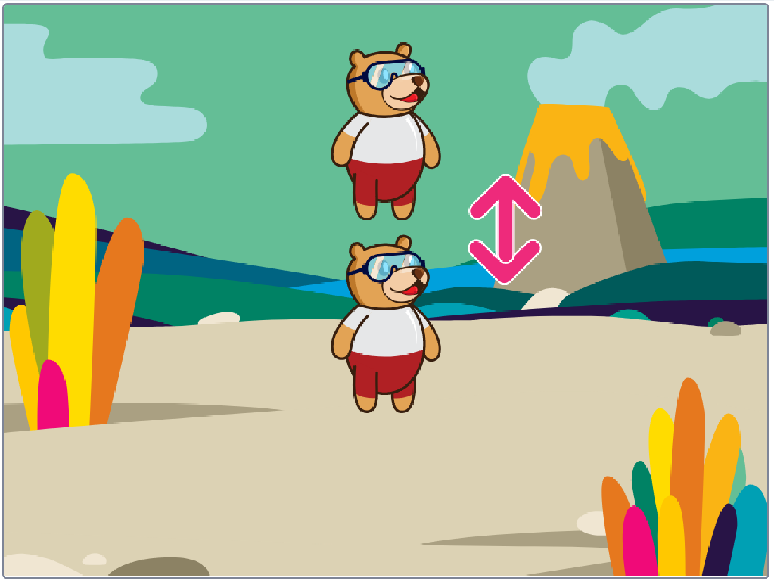
STEP 3: Jumping Animation
Using following blocks from motion palette, we will make Tobi jump.

Slide 12
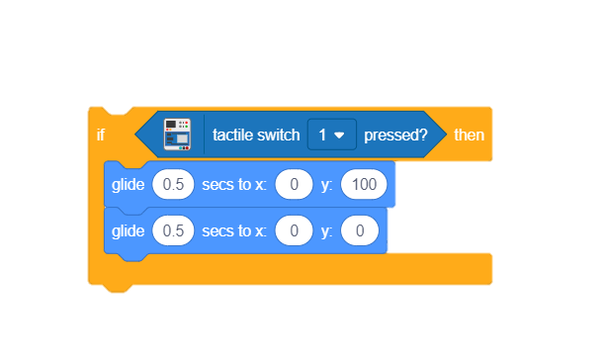
STEP 4: Sense the Switch
Tobi should jump whenever we press the tactile switch of evive, For this, We will use tactile switch block from evive palette.
To set the condition, we will use if block from control palette.

Slide 13
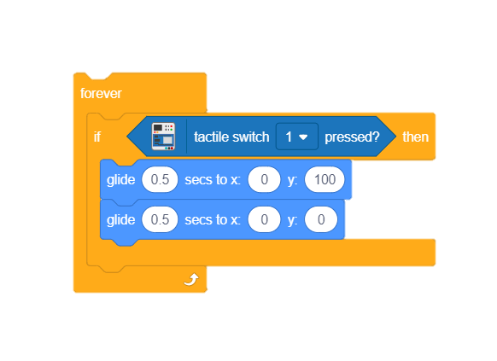
STEP 5: Sense Continuously
Add forever block to sense continuously.

Slide 14
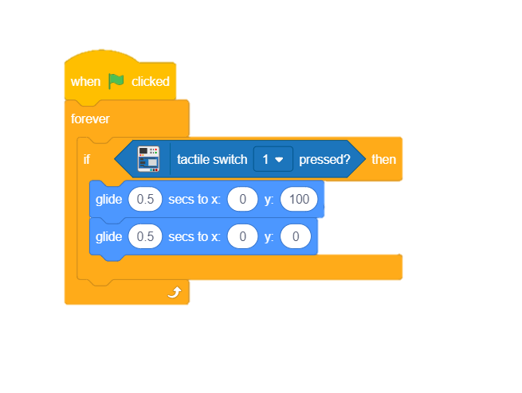
STEP 6: Add the Hat Block
Finally, add when flag clicked block. Now flag button will act as trigger.

Slide 15
STEP 7: Let’s Play
Maximize the stage and make the Tobi jump.

