Slide 1
Face Detection
Session 14

Slide 2
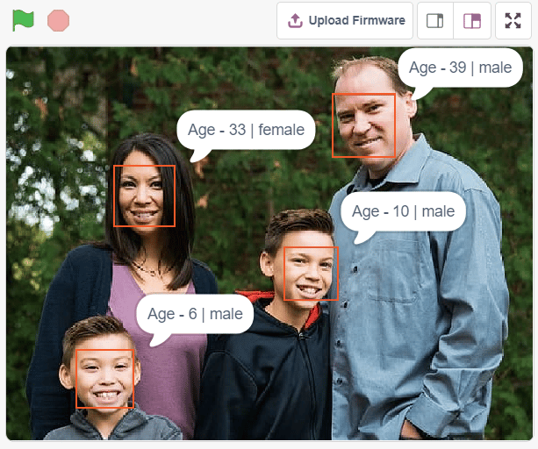
What you will learn:
Face Detection in image (as shown in the image)
Face detection functions in PictoBlox

Slide 3
Face Detection
Definition- Face detection is the action of locating human faces in an image and optionally, returning different kinds of face-related data.
Face recognition has become one of the most promising applications of computer vision (CV). Face detection can be considered to be a substantial part of face recognition.
Why face detection in images is complicated?: Human faces are widely different from one another! They can have different poses, expressions, position, and orientation, skin color, have glasses or facial hair or not, etc. Then, there are also differences in camera gain, lighting conditions, and image resolution.

Slide 4
How do we detect faces?
There are a few methods that you can use to detect faces such as:
Knowledge-Based detection
Feature-Based detection

Slide 5
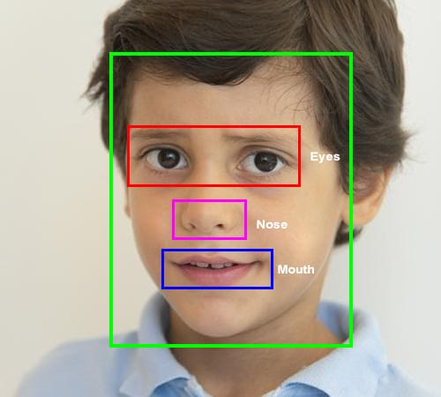
Knowledge based Detection
The knowledge-based method depends on a set of rules and is based on human knowledge to detect the faces.
E.g. A face often appears with two eyes that are symmetric to each other, a nose and a mouth.

Slide 6
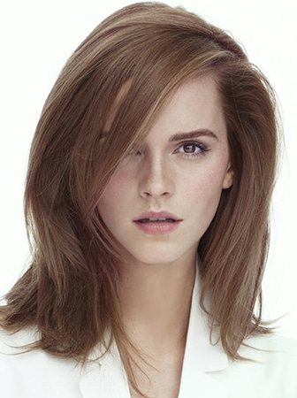
Knowledge based Detection
Pros
Easy to come up with simple rules.
Based on the coded rules. Facial features in an input image are extracted first, and face candidates are identified.
Cons
Difficult to translate human knowledge into rules precisely.
Detailed rules fail to detect faces, like the rule that, ‘A person must have two eyes’: According to this rule, no face will be identified in this image.

Slide 7
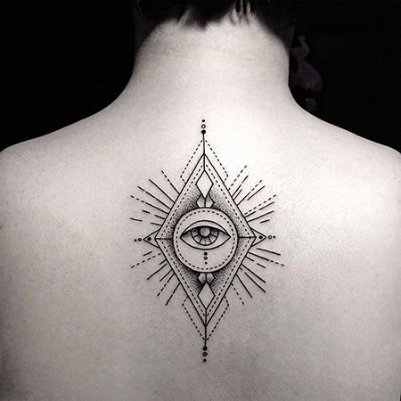
Knowledge based Detection
General rules may find many false positives: Like there is an eye in a face. According to this, the face will be identified in this tattoo of a similar-looking eye.
This approach alone is insufficient and unable to find many faces in multiple images.

Slide 8

Feature-Based Detection
Feature-based detection uses what are known as face landmarks to detect faces.
Face landmarks are a set of easy-to-find points on a face, such as the pupils or the tip of the nose.
By default, there are 68 predefined landmark points. The following image shows all landmark points.
The feature-based method detects faces by extracting these face landmarks.

Slide 9
Feature-Based Detection
Pros
Features are invariant to pose and orientation change. That is, face gets detected even if it is moved, rotated, or distorted in the image.
This method has a higher chance of face detection (compared to other methods).
Cons
Difficult to locate facial features due to noise in the images.
Difficult to detect features in complex backgrounds.

Slide 10
Face Detection Functions in Python using PictoBlox

Slide 11
Python Functions for Face Detection
In order to use the Face Detection functions for python in PictoBlox, we must first build the face detection object. For this follow the steps:
First, create a new project in PictoBlox and select Python Coding as your coding environment.
Now write the below code in the scripting area. This code, builds a face detection object and store it in the variable ‘fd‘.
Now, we will use the variable ‘fd‘ that contains the face detection object to build the Face Detection functions.
fd = FaceDetection()

Slide 12
Facial Detection Function
To execute face detection, we can use two different functions, one to detect face from the camera and another to detect face from the stage.
To detect face from the camera, use:
To detect face from the stage, use:
The above two functions analyses the image (from camera or stage) and saves the face information locally. This face information can then be accessed using other python functions.
You have to run these functions every time you want to analyze a new image from the camera or stage.
fd.analysecamera()
fd.analysestage()

Slide 13
Controlling Camera Feed
You can control the camera feed on the stage using the following function:
This function has two parameters, which you can change as follows:
Camera State:
off - The video feed on the stage will stop.
on – The video feed on the stage will start.
on flipped - The video feed on the stage will start with the video mirrored. So, your right hand will be shown as left hand and vice versa.
fd.video(“on”, 0)

Slide 14
Controlling Camera Feed
Transparency: This parameter makes the video translucent. You can give any value from 0 to 100.
At value ‘0’, the camera feed will be shown as it is on the stage.
At value ‘50’, the camera feed will be semi-transparent.
At value ‘100’ the camera feed will fade out completely from the stage.

Slide 15
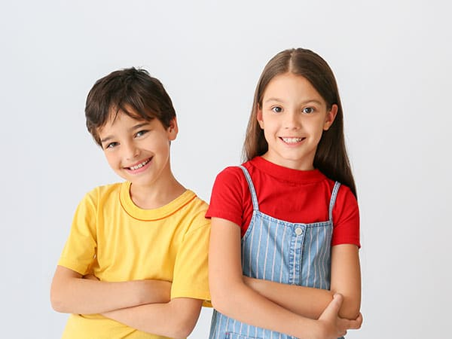
Example: Analyzing Image on the Stage
Download this image from the link: https://ai.thestempedia.com/wp-content/uploads/2022/02/Boy-and-Girl.jpg
In PictoBlox, turn off the camera by running the function fd.video(), and choosing the first parameter ‘off’ as shown.
Next upload the downloaded image as backdrop, by clicking the Upload Backdrop button.

Slide 16
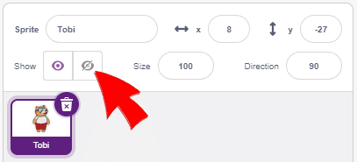
Example: Analyzing Image on the Stage
Select Tobi sprite and hide it.
Now, to analyse image from the stage area, we use the function analysestage().
Now we will see what things we get when we analyze images in face detection.
fd.analysestage()

Slide 17
Get number (#) of faces
Once you have analyzed the images, you can use the function count() to get the number of faces recognized from the image.
If we want to output the number of faces detected in the terminal of PictoBlox, we need to first convert the output of fd.count() to string.
We do this by using the inbuilt function str() of python. Finally, we use print() function on it to output it in the terminal, as shown.
fd.count()
print(str(fd.count()))

Slide 18
Get expression of face
In order to get the expression of face from the camera, we can use expression() function.
This function reports the recognized expression of the selected face. If no face is detected, then it reports NULL.
We can make the sprite say the emotion that is detected from the camera using the sprite function say().
fd.expression()
sprite.say()

Slide 19

Get expression of face
The entire code must include the following code as shown:
sprite = Sprite(“Stage”)
fd = FaceDetection()
sprite.say(fd.expression())

Slide 20
isexpression(face_number, emotion)
In order to check whether a particular face has a particular emotion or not, we can use the function isexpression().
If the emotion matches, then the block returns the value true, otherwise it returns the value false.
This function has two parameters. The first parameter denotes the face number that you want to analyze and the second parameter denotes the emotion that you want to check on the face.
Example: If we want to check whether for face 1 in the image, the emotion is ‘happy’ or not, we code:
Similarly, for checking ‘angry’ emotion on face 2, we code:
fd.isexpression(1, ‘happy’)
fd.isexpression(2, ‘angry’)

Slide 21
Getting positions of the face
In order to get various attributes of the face that is detected, like its x-coordinate, y-coordinate, width and height we use a bunch of face detection functions:
X position:
Y position:
Width:
Height:
All the 4 functions above, have a single parameter that denotes the face number.
Note: These functions report an accurate position, when the image is analyzed from stage or camera feed.
fd.x(1)
fd.y(1)
fd.width(1)
fd.height(1)

Slide 22
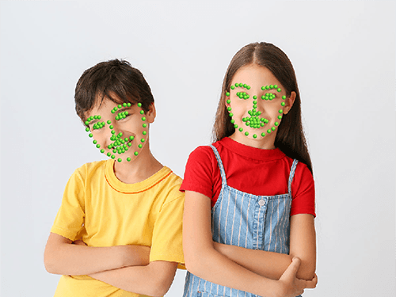
Get Position of Landmarks of Face
Each face that is detected in PictoBlox using the face detection module has landmarks (from 1 to 68), as shown in the image below.
We can get the x and y position of any of these landmarks for any face using the below two functions:
For getting the x-position:
For getting the y-position:
fd.landmarkx(face_num, landmark_num)
fd.landmarky(face_num, landmark_num)

Slide 23
Get Position of Landmarks of Face
Example:
To get the x-position of the 1st image, 20th landmark, we code:
To get the y-position of the 2nd image, 1st landmark, we code:
fd.landmarkx(1, 20)
fd.landmarky(2, 1)

