Slide 1
AI in 21st Century
Session 13

Slide 2
Artificial Intelligence
Artificial Intelligence has now been ingrained in today’s society.
It has applications ranging from web searching to surfing social networking sites.
Artificial Intelligence is undeniably changing the productivity and workflow of a variety of sectors throughout the world.
In this lesson, we will talk about how AI is impacting our lives, how does it help in building smart cities, and what will be the future of AI.

Slide 3
Topics Covered in this Lesson
How AI is shaping Smart Cities
AI as a career option, and its future
AI’s Contribution to National Building & Development

Slide 4
Key Learning Outcomes
At the end of the lesson, you will be able to:
Gain an awareness of where Artificial Intelligence is relevant in your own lives.
Correlate with the real-world applications of AI to generate an AI mindset.

Slide 5
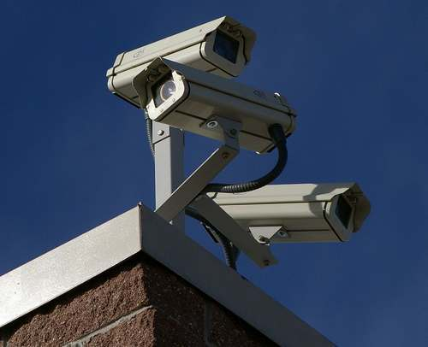
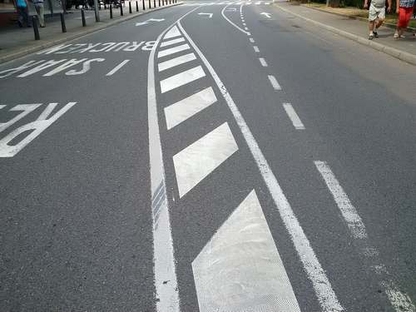
How AI is Shaping Smart Cities
Security: Security cameras that use AI have the ability to analyze footage in real-time and detect criminal behavior which can then be instantly reported and dealt with.
Maintenance: AI can be used to analyze road imagery to then assess issues and produce cost-effective solutions.

Slide 6
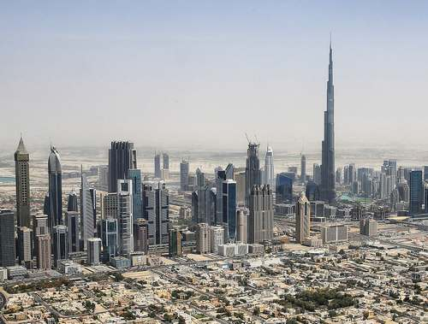
How AI is Shaping Smart Cities
Predicting Future Needs: Better prediction of future needs of the people Ex: Using energy tracking technology to know:
When new energy sources sources will be needed, or
What more sustainable energy sources can be implemented.

Slide 7
How AI is Shaping Smart Cities
Controlling Pollution: Using AI and machine learning to analyze the current pollutants and predict the pollution levels for the next 2 hours. This type of technology allows authorities to make decisions in advance to reduce their effect on the environment.

Slide 8
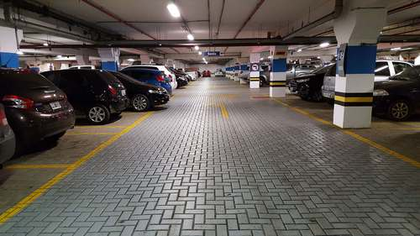
How AI is Shaping Smart Cities
Parking Systems: Using license plate recognition technology, car parks are able to detect cars that have outstayed hours, this can also enforce payments and tickets.

Slide 9
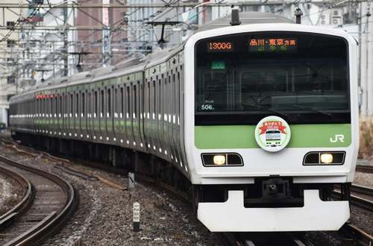
How AI is Shaping Smart Cities
Public Transportation: Public transport users can receive and access live updates and tracking, this would improve time saving and customer satisfaction.
Automated buses can also be planned to be used within cities, these can reduce emissions, improve routes, and increase the bus frequency.

Slide 10
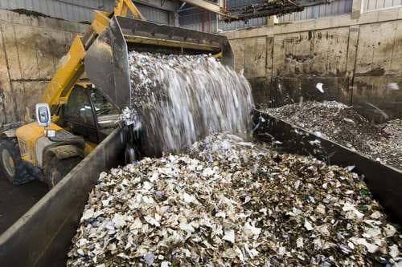
How AI is Shaping Smart Cities
Waste Management: Smart waste management using AI will allow cities to track recycling, and identify what can be recycled, based on the type of waste produced in each area.

Slide 11
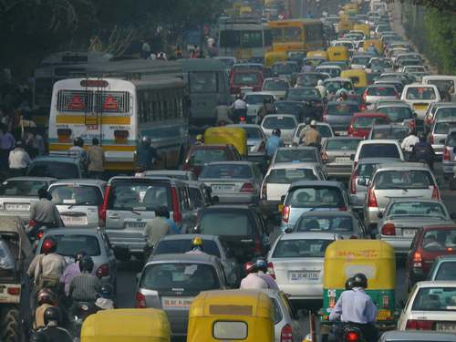
How AI is Shaping Smart Cities
Traffic Management: AI implementation in transportation can reduce traffic and road accidents. AI can also be used throughout traffic camera systems to detect road crimes in real-time.

Slide 12
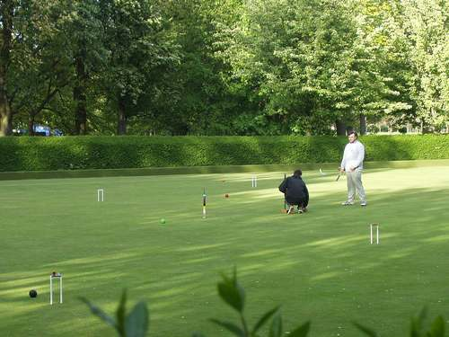
How AI is Shaping Smart Cities
Environment: AI can be used to track the local environment, ex: temperature, rain, pollution levels etc. This can allow the authorities of the city to make well-informed decisions that are best for the environment.

Slide 13
AI as a Career Option and Its Future
Artificial intelligence will transform the global economy, and AI jobs are in high demand.
Getting an education in AI is challenging and requires persistence and personal initiative.
All AI careers are future-proof, meaning they are likely to survive well into the future.

Slide 14
Starting a Career in AI
Self-driving cars, robotic assistants, and automated disease diagnosis are all products of an emerging AI revolution that will reshape how we live and work.
There are limitless opportunities for professionals who want to work on the cutting edge of AI research and development.
AI will be a great transformer, it will improve the efficiency of many sectors, and enable the creation of higher-value services. This can lead to overall economic growth.

Slide 15
Getting an AI education
AI has a high learning curve, but for motivated students, the rewards of an AI career far outweigh the investment of time and energy.
Curiosity, confidence, and perseverance are good traits for any student looking to break into an emerging field, and AI is no exception.
A good place to start is computer science coursework, getting familiar with the basics of data science, machine learning, and Java.
There are a number of new undergraduate and graduate programs popping up every day that are designed to prepare someone specifically to work in AI.

Slide 16
Landing a Job in AI

Slide 17
National Building & Development using AI
Artificial Intelligence is becoming a new wave in global politics, and it is going to play a pivotal role in power dynamics among nations.
Many countries are investing massively in the advancement of this technology, and it has become an important aspect of economic, defense, and foreign policy.
The usage of AI is not limited to Information Technology (IT). Breakthroughs in Machine Learning, that engages in ‘deep learning’ and the ‘advancement of computer systems’ has gone beyond IT and expanded to health, education, defense, art, and social sector.

Slide 18
National Building & Development using AI
Artificial Intelligence can be a game-changer for the nation-building process.
We can achieve our goal of socioeconomic change that empowers everyone to lead life to the fullest possible using AI.
NITI Aayog is also trying to use AI for creating insightful policy-making processes.

Slide 19
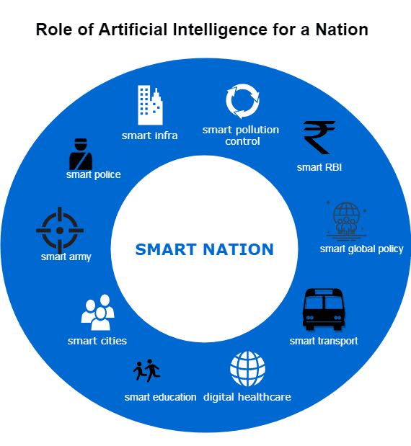
Role of AI for a Nation

Slide 20
National Building & Development using AI
Many countries such as the United States, China, Israel, Canada, EU member countries, and Japan promote AI and have made it an integral part of their economy, security, and defense sector.
In India, AI has been mostly used by Industries and corporates (like Amazon, Flipkart, SymphonyAI, etc.), and the expertise of AI is mainly in a few hands (mainly technocrats).
Hence a huge potential, lay unexplored in India in the field of AI.

