Slide 1
Traffic Lights with Quarky
Session 9

Slide 2
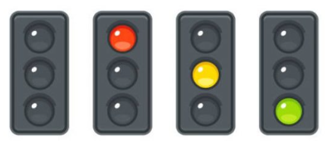
How does traffic signals work?
The traffic signals have 4 states:
No Lights
Red Light – STOP
Yellow Light – LOOK
Green Light – GO
The lights cycle through red, yellow, and green at regular intervals to control road intersections’ traffic flow.
In this activity, we’re going to see, how we can display these Traffic Lights on the LED matrix of Quarky.

Slide 3
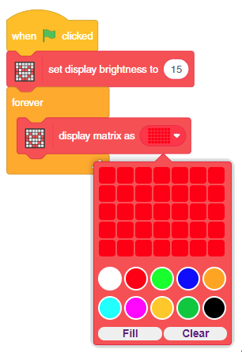
Let’s Code
Include the blocks in the script as shown in the image -:
Step | Block | Palette
1. | when flag clicked | Events
2. | set display brightness to (15) | Display
3. | forever | Control
4. | display matrix as () | Human Body

Slide 4
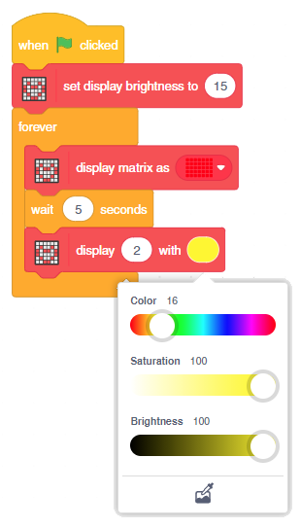
Let’s Code
Add wait () seconds block under the display matrix as (red) block and set the waiting time as 5 seconds.
Go to the Display palette and add a display () with () block into the scripting area. In the first space, enter 2.
Now, within the second space of display () with () block, set the color of the LED to yellow (you can always choose the color of your choice) from the drop-down.
This will display number 2 in yellow color on the Quarky LED matrix.

Slide 5
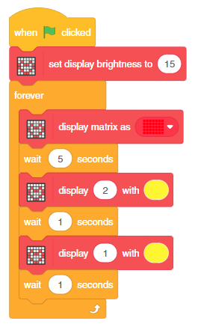
Let’s Code
Similarly, add another wait () seconds block and set the waiting time as 1 second.
Add another display () with () block below wait () seconds block. In the space, enter 1. Then, set the color of the LED to yellow from the drop-down.
Again, add another wait () seconds block and set the waiting time as 1 second.

Slide 6
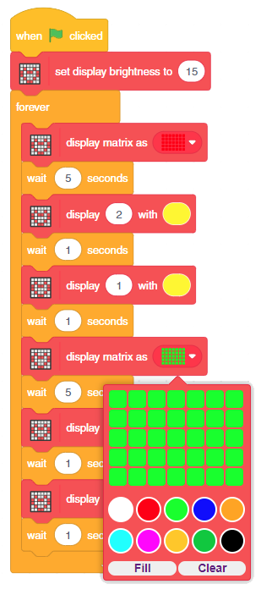
Let’s Code
We wrote the code for red color, now we also need to add the code for green color.
But instead of writing the code again (for green) we can simply duplicate the code (from red).
For this, Right-click on the display matrix as (red) block and click on duplicate to duplicate the code. Now drag the code at the end.
Set the color to Green.
Duplicated code (Green)

