Slide 1
AI Space Battle Game
Session 6

Slide 2
AI Space Battle Game

Slide 3
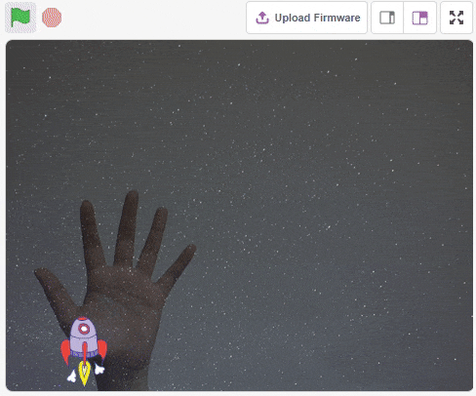
Overview
We have created the Space Battle game in the past sessions. How about making that game where you can control the Rocketship using your fingertips? Sounds pretty cool, right?
In this lesson, we will make a hand controlled space battle game in PictoBlox, and control the Rocketship using the tip of our fingers.

Slide 4
Let us start!
We must first open the file we made for our Space Battle Game.
Here, the only script we will modify, is the script of Rocketship.
Hence select the Rocketship sprite from Stage Palette and let us start!

Slide 5
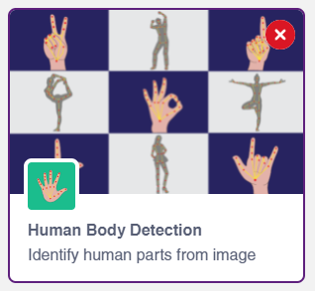
Add the Human Body Detection Extension
Click on Add Extension (on bottom left corner) and add the Human Body Detection extension to your palettes.

Slide 6
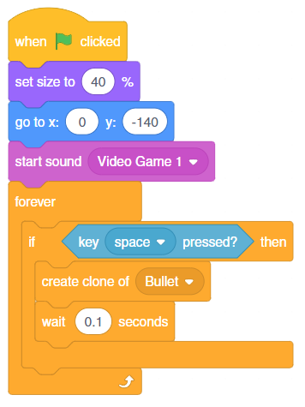
Let’s Code
Delete the if () then block for left and right arrow keys.
Your script for Rocketship must look like shown in the image (Right Side).

Slide 7
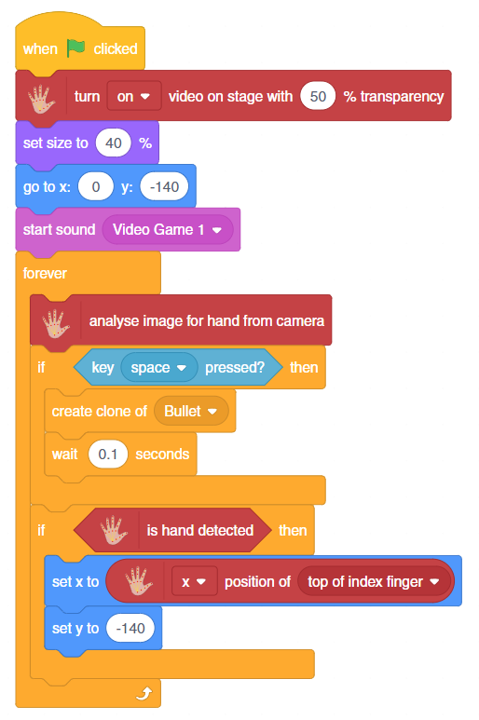
Let’s Code
Include the blocks in the script as described below -:
Step | Block | Palette
1. | turn () video on stage with () % transparency | Human Body
2. | analyse image for hand from camera | Human Body
3. | If () then | Control
4. | is hand detected | Human Body
5. | set x to () | Motion
6. | set y to () | Control

Slide 8
Conclusion
In this session, we removed the control of Rocketship using arrow keys from our script and instead added the script for controlling the Rocketship using our hand movements.
Run the project, and have fun!

