Slide 1
Finger Tracking with AI
Session - 5

Slide 2
Session Outline.
In This session you’ll understand How to move a sprite in PictoBlox by tracing your finger in the air.

Slide 3
Finger Tracking with AI

Slide 4
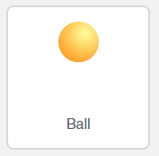
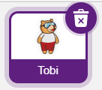
Let’s Code
Click on choose a sprite button and select a Ball sprite from the library.
Click on Tobi and then on the delete symbol, to delete Tobi’s sprite.
Delete
symbol

Slide 5
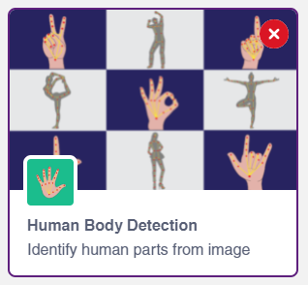
Add the Human Body Detection Extension
Click on Add Extension (on bottom left corner) and add the Human Body Detection extension to your palettes.

Slide 6
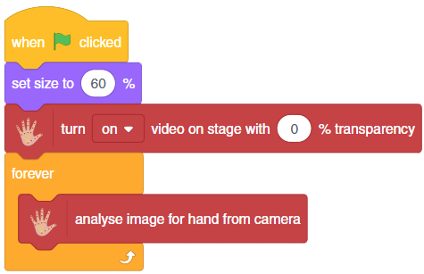
Let’s Code
Add the script as shown below, to turn on the camera and start analyzing your hand.
Step | Block | Palette
1. | when flag clicked | Control
2. | set size to () % | Looks
3. | turn () video on stage with () % transparency | Human body detection
4. | forever | Control
5. | analyse image for hand from camera | Human body detection
Notes:
we need to turn the camera on, thus snap a turn on video on stage with a 0% transparency block from the Human Body Detection palette.

Slide 7
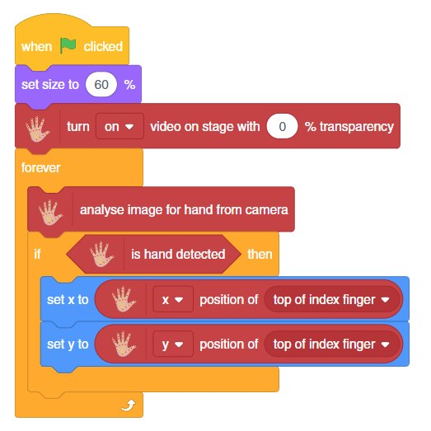
Let’s Code
If a hand is detected in the camera, the x and y position of the ball is set equal to the x and y position of your index finger.
Step | Block | Palette
1. | If () then | Control
2. | is hand detected | Human body detection
3. | set x to () | Motion
4. | set y to () | Motion
5. | () position of () | Human body detection

Slide 8
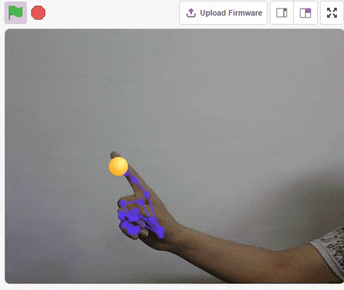
Testing your script

Slide 9
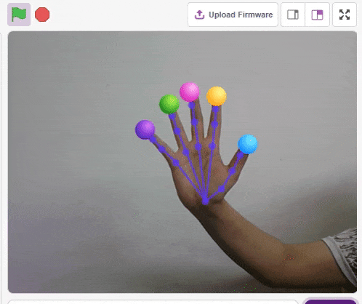
Challenge
Create a program to track all your five fingers

