Slide 1
Space Battle Game
Session 4

Slide 2
Activity: Space Battle Game – Part 3

Slide 3
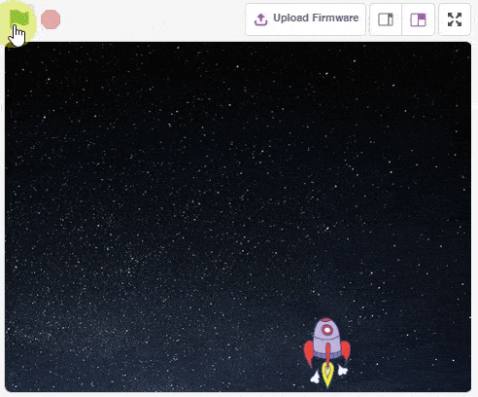
Overview
In this activity we will add the scripts that will allow us to add ghosts in our game.
We can then shoot these ghosts with our Rocketship and have so much fun!

Slide 4
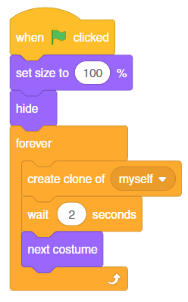
Creating Multiple Ghosts - Let’s Code
Choose the sprite ‘Ghost’, and add the script as shown -:
when flag clicked - Events
set size to ( )% - Looks
hide - Looks
forever - Control
create clone of ( ) - Control
wait ( ) seconds - Control
next costume - Looks
Step | Block | Palette
1. | when flag clicked | Control
2. | Set size to () % | Looks
3. | hide | Looks
4. | forever | Control
5. | Create clone of () | Control
6. | wait () seconds | Control
7. | next costume | Looks

Slide 5
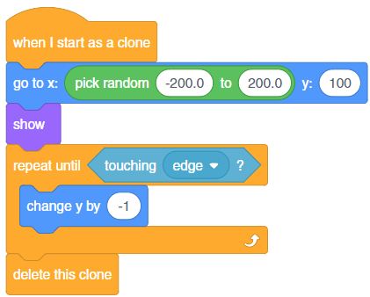
Assigning Actions to the Ghosts - Let’s Code
Step | Block | Palette
1. | when I start as a clone | Control
2. | got to x: () y: () | Motion
3. | Pick random () to () | Looks
4. | show | Looks
5. | repeat until () | Control
6. | touching () ? | Sensing
7. | change y by () | Motion
8. | delete this clone | Control

Slide 6
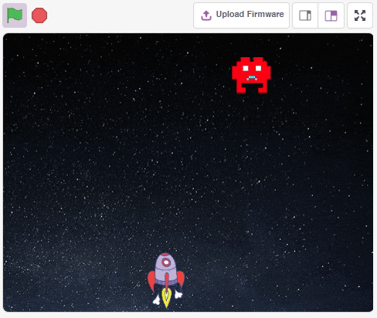
Assigning Actions to the Ghosts - Let’s Code
Run the script and you will see ghosts appearing in random positions on the topof the Stage and moving down.

Slide 7
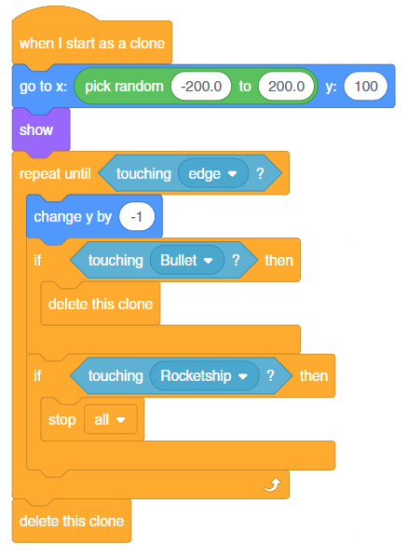
Assigning Actions to the Ghosts - Let’s Code
If a bullet touches a ghost, destroy that ghost (clone).
If a ghost touches the Rocketship, stop the game.
Step | Block | Palette
1. | if () then | Control
2. | touching () ? | Sensing
3. | delete this clone | Control
4. | stop () | Control

Slide 8
Let’s Code
The game is now ready to play. Start the game by clicking on the green flag and have fun!

