Slide 1
Expression Mimicking Robot
Session 21

Slide 2
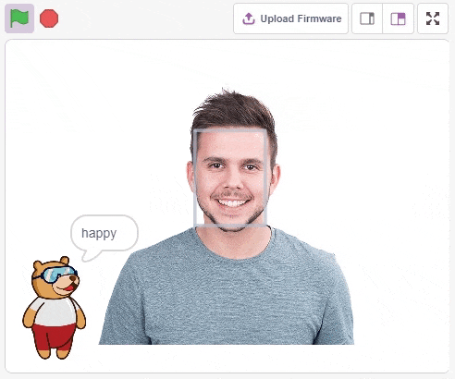
Introduction
In this activity, we’re going to write a script that will first, detect our facial expressions.
Second, these facial expressions will then be mimicked by the Quarky robot.

Slide 3
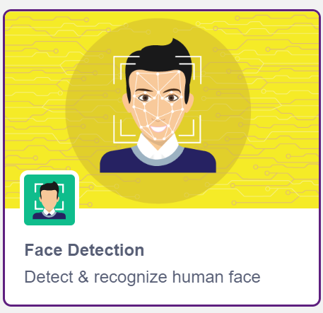
Face Detection Extension
Add Face Detection Extension by clicking on the Add Extension button (bottom left corner).

Slide 4
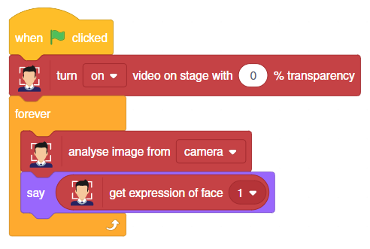
Let’s Code
Open a New File in PictoBlox.
Add the following code in your scripting area.
Script to detect our face
Step | Block | Palette
1. | when () clicked | Events
2. | turn () video on stage with () % transparency | Face Detection
3. | forever | Control
4. | analyse image from () | Face Detection
5. | say () | Looks
6. | get expression of face () | Face Detection

Slide 5
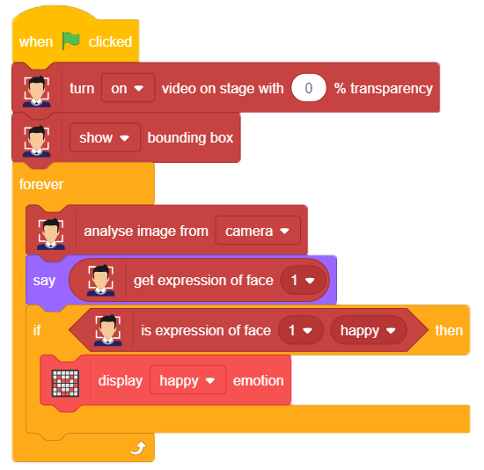
Let’s Code
Add the script to detect happy emotion and have it mimicked by quarky.
Step | Block | Palette
1. | if () then | Control
2. | is expression of face () () | Face Detection
3. | display () emotion | Motion
Add Block

Slide 6
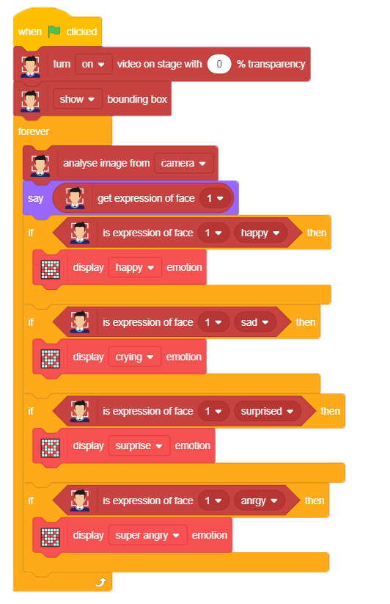
Let’s Code
Duplicate the if () then block, to detect and mimic other emotions, like:
Crying
Surprise
Super angry
You can add even more emotions if you want!
Duplicated Blocks

Slide 7
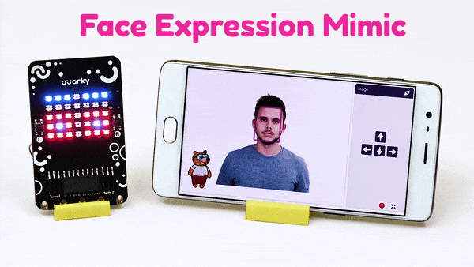
Run the Script
Finally, click the green flag to run the script and have fun, watching your Quarky mimic your emotions.

