Slide 1
Face Expression Recognition
Session 20

Slide 2
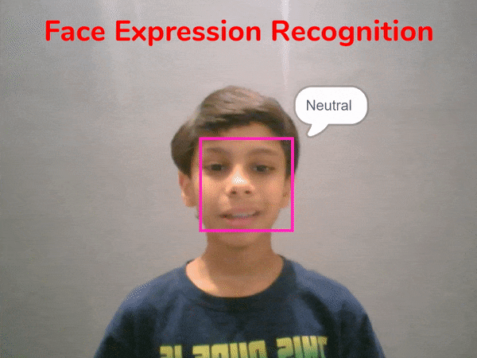
Introduction
In this project, we will make a script that can detect the expressions on your face using the device camera (computer/mobile).

Slide 3
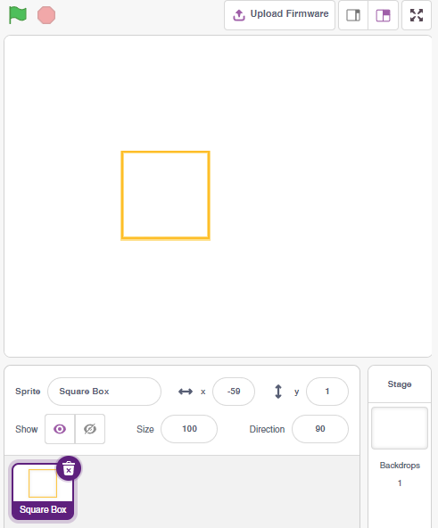
Setting up the stage
Add a new sprite called Square Box by clicking on Choose a Sprite (Bottom right corner).
Delete the Tobi Sprite.

Slide 4
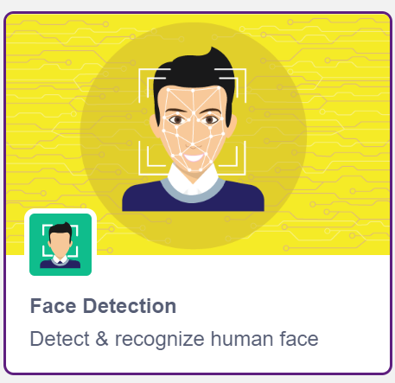
Face Detection Extension
Add Face Detection Extension by clicking on the Add Extension button (bottom left corner).

Slide 5
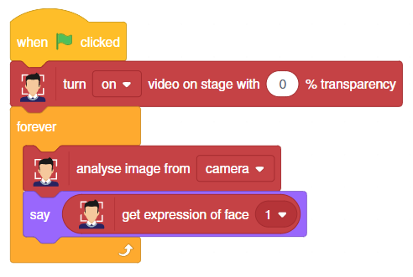
Let’s Code
Open a New File in PictoBlox.
Add the following code in your scripting area.
Step | Block | Palette
1. | when () clicked | Events
2. | turn () video on stage with () % transparency | Face Detection
3. | forever | Control
4. | analyse image from () | Face Detection
5. | say () | Looks
6. | get expression of face () | Face Detection

Slide 6
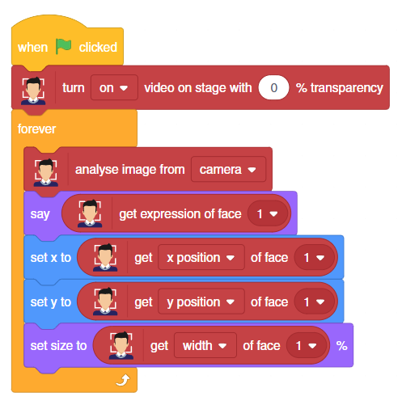
Let’s Code
Add rest of the code as shown
Step | Block | Palette
1. | set x to () | Motion
2. | get () of face () | Face Detection
3. | set y to () | Motion
4. | set size to () % | Looks
Add
Blocks

Slide 7
Run the Script
Finally, click the green flag to run the script and try showing different expressions to the camera.

