Slide 1
Self Driving Car
Session 17

Slide 2
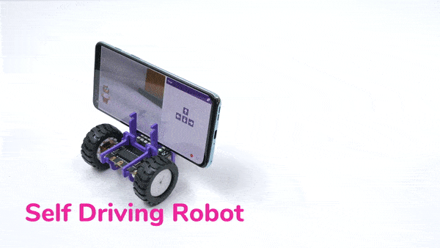
Introduction
In the previous session, we learnt about sign detection.
In this session, we want the Quarky car to recognize those very signs in its path, and perform the following actions:
Sign | Motion
Go | Move Forward
Turn Left | Move Left
Turn Right | Move Right
U-Turn | Move Backward

Slide 3
Let’s Code
Open the script, Sign Detection in Self Driving Cars in PictoBlox that we have made in the previous session.
Switch on your Quarky and connect it to the Pictoblox (via Bluetooth).
We will make changes to this very code to build our Self Driving Car.

Slide 4
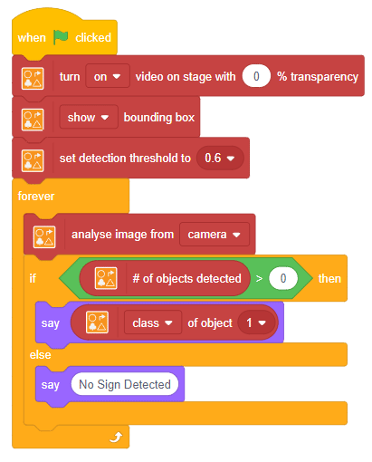
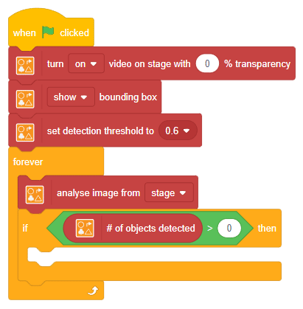
Edit the code
OLD CODE
NEW CODE

Slide 5
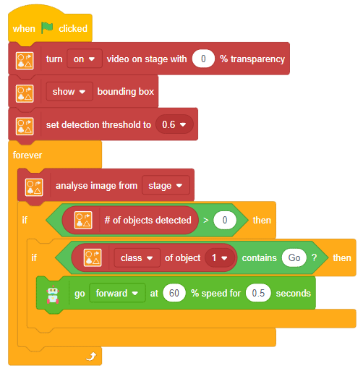
Let’s Code
Add another if () then block within the if () then block and write the code as shown.
Step | Block | Palette
1. | if () then | Control
2. | () of object () | Autonomous Driving
3. | () > () | Operators
4. | () contains () ? | Operators
5. | go () at ()% speed for () seconds | Robot

Slide 6
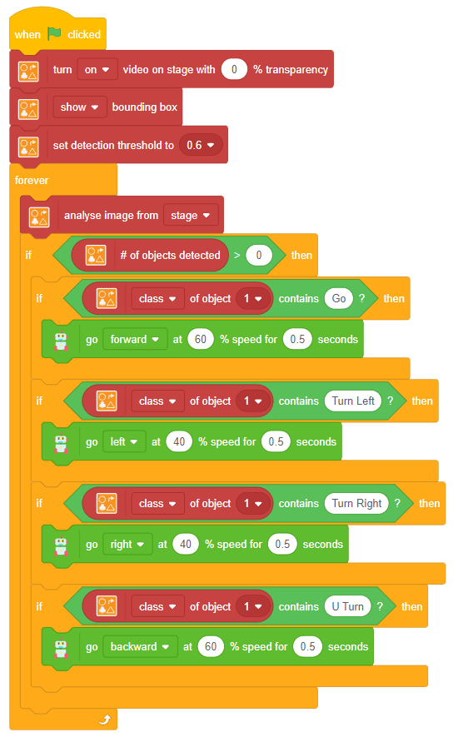
Let’s Code
Duplicate the if () then block three more times for:
  Turn Left
  Turn Right
  U-Turn
Duplicated
Blocks

Slide 7
Run the Script
Finally, click the green flag to run the script and have fun with your Self driving Car

