Slide 1
Sign and Landmark Detector
Session 16

Slide 2
Overview
In this session and the next, we will learn about self-driving cars.
For this, we must first understand, how a self-driving car will detect the signs and landmarks.

Slide 3
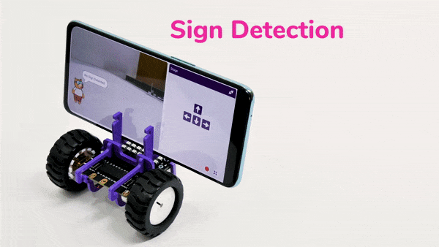
Overview
We will understand using our Quarky, by following these steps-:
We’ll be using our Smartphone’s camera to detect road signs and objects.
We’ll bring a random sign in front of the camera.
PictoBlox will detect it and tell us which sign it is.

Slide 4
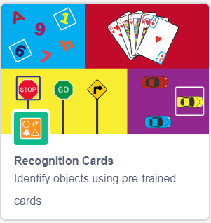
Let’s Code
Open a New File in PictoBlox.
Add a when flag clicked block from the Events palette into the scripting area.
Next, click on Add Extension button (bottom-left corner of the screen) and add the Recognition Cards extension, to add its blocks to your palette.

Slide 5
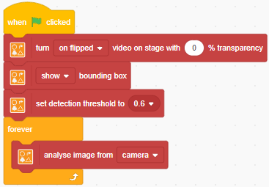
Let’s Code
Add the blocks in your scripting area as shown -:
Step | Block | Palette
1. | turn () video on stage with () % transparency | Recognition Cards
2. | () bounding box | Recognition Cards
3. | set detection threshold to () | Recognition Cards
4. | forever | Control
5. | analyse image from () | Recognition Cards

Slide 6
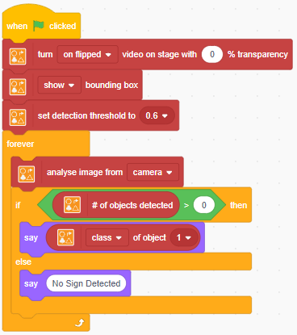
Let’s Code
Add the below shown blocks within the forever loop -:
Step | Block | Palette
1. | if () then else | Control
2. | () > () | Operations
3. | # of objects detected | Recognition Cards
4. | say () | Control
5. | (class) of object () | Recognition Cards
Blocks
To
add

Slide 7
Run the Script
Now, run the script by clicking the green flag.
Also bring the sign and landmark cards in front of the camera one by one, to check whether the script is running properly.

