Slide 1
Basics of Robotics
Session 15

Slide 2
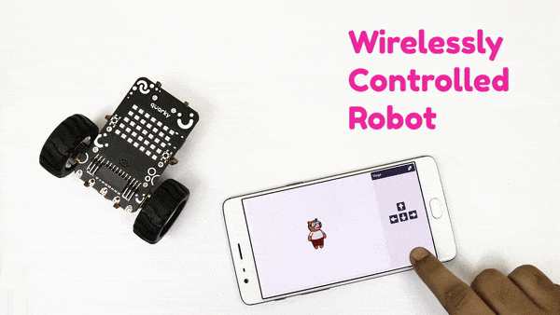
Introduction
In this session, we will learn how to control a Robot. Let’s get started!

Slide 3
Understanding the Logic
We’re going to control Quarky wirelessly, using the arrow keys of your desktop/laptop or mobile phone within the PictoBlox mobile app.
Pressing a particular key will produce a particular effect as shown in the table.
Key | Effect
Up arrow | Move Forward
Down arrow | Move Backward
Left arrow | Move Left
Right arrow | Move Right
None | Stop Moving

Slide 4
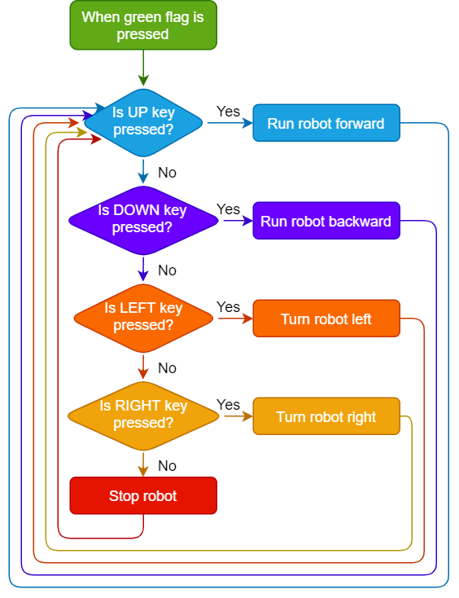
Understanding the Logic

Slide 5
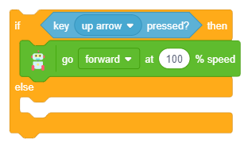
Let’s Code
Open a New File in PictoBlox.
Switch on your Quarky and connect it to the Pictoblox.
Add the following code in your scripting area.
Step | Block | Palette
1. | if () then else | Control
2. | key () pressed | Sensing
3. | go () at ()% speed | Robot

Slide 6
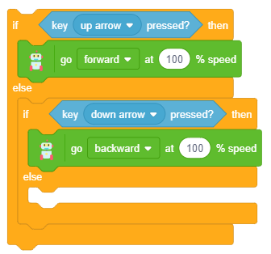
Let’s Code
We have added the block of up arrow key for forward motion.
Let us now add the block for down arrow key for backward motion.
Duplicate the if then else block and drag it within the else-arm.
Duplicated
Block

Slide 7
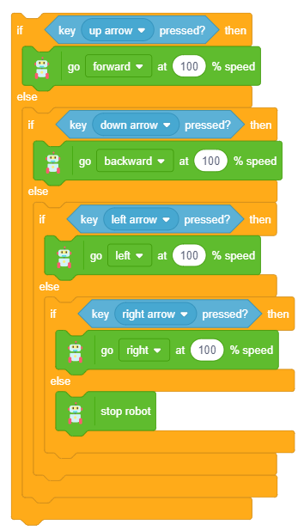
Let’s Code
Duplicate the if then else block for left arrow key for turning left.
Similarly, duplicate the if then else block for right arrow key for turning right.
Add stop robot block from the Robot palette in the last else-arm.
Duplicated
Blocks

Slide 8
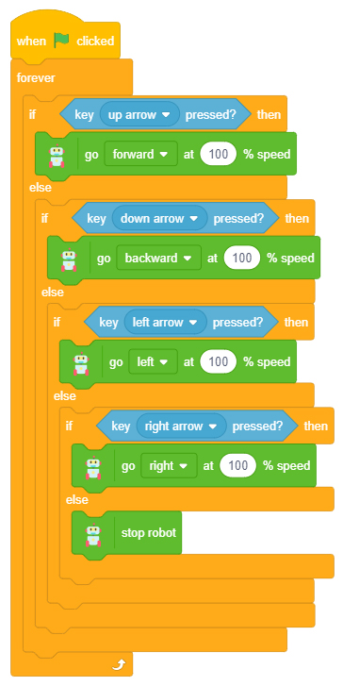
Let’s Code
Final
Script
Complete the script by adding a forever & when flag clicked blocks at the top.
This will make the script run continuously (forever), whenever the green flag is clicked.

Slide 9
Run the Script
Finally, click the green flag to run the script and have fun playing with Quarky!

