Slide 1
Road Sign Detector
Session 14

Slide 2
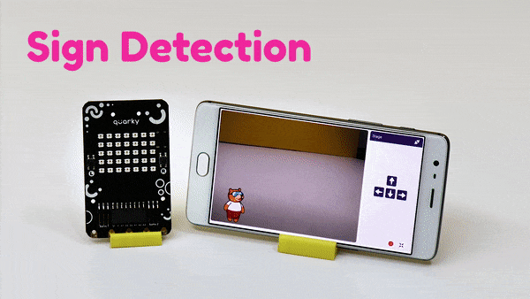
Introduction
We’re going to make a road sign detector using Quarky, for application as a road safety system.
Our system will detect different road signs using a camera and display them on Quarky’s LED matrix.

Slide 3
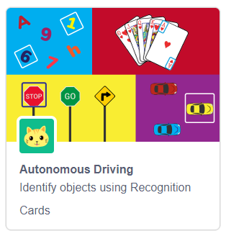
Let’s Code
Start a new project in PictoBlox.
Go to the Events palette and add a when flag clicked block into the scripting area.
Now, To detect the traffic signs, we’re going to use the Autonomous Driving palette. Add the Autonomous Driving palette by clicking on the Add Extension button.

Slide 4
AI Confidence
Now, we’re going to use a concept called confidence to make sure that our system detects the objects correctly. Confidence tells us how sure/confident the machine is, of the object, it has detected. E.g., If PictoBlox detects an orange (fruit) and its confidence/threshold is 0.6 then it means that it is 60% sure that the object it has detected is an orange.
If the confidence/threshold is too high then, it makes detecting objects difficult, especially if it is far away from the camera.
If the confidence/threshold is too low then, the machine may detect some other object or many objects at once!
So, we must choose a confidence value that is neither too low nor too high.

Slide 5
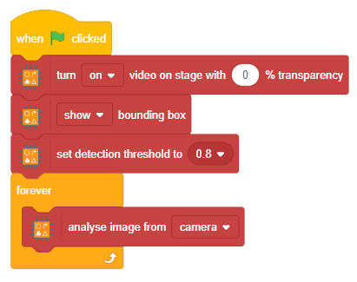
Let’s Code
Add the following code in your scripting area.
Step | Block | Palette
1. | Turn () video on stage with () % transparency | Autonomous Driving
2. | (show) bounding box | Autonomous Driving
3. | Set detection threshold to (0.8) | Autonomous Driving
4. | forever | Controls
5. | Analyse image from (camera) | Autonomous Driving

Slide 6
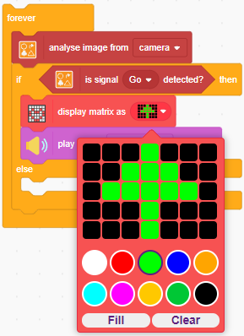

Let’s Code
Add the following code within the forever block as shown -:
Step | Block | Palette
1. | if () then else | Control
2. | is signal () detected? | Autonomous Driving
3. | display matrix as () | Display
4. | play sound () until done | Speaker
Blocks
to
add

Slide 7
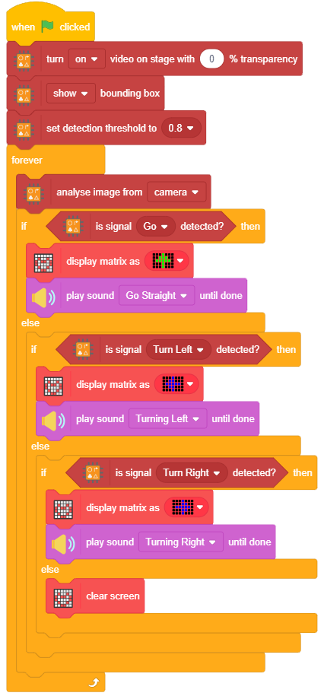
Let’s Code
We have added an if () else then block for Go sign. Similarly, we need two other if () else then blocks for-:
  Turn Left sign and
  Turn Right sign
For this, duplicate the if () else then block and add it in the else-arm.
Do this for both the signs.
Finally, add a clear screen block from display palette at the final else-arm.
Duplicated
Blocks

Slide 8
Run the Script
Finally, click the green flag to run the script and enjoy!
Note: If you are running the script using the PictoBlox App on your smartphone then to use the back camera of the phone, you need to change the setting. Go to Settings, click on Video Tab and select the required camera.

