Slide 1
Traffic Lights with Quarky
Session 13

Slide 2
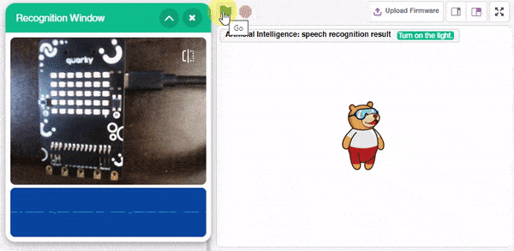
Introduction
In this lesson, we are going to create a Smart Lamp.
The lamp will turn on when it hears ON and will turn off when it hears OFF. Just like Alexa!

Slide 3
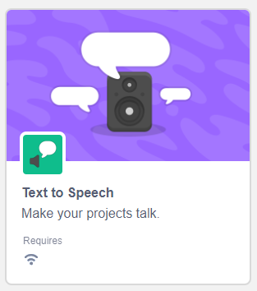
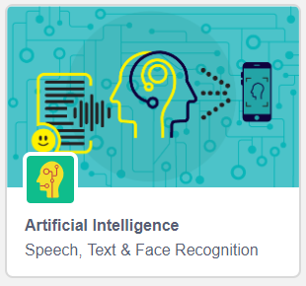
Let’s Code
Start a new project in PictoBlox.
Connect your Quarky with PictoBlox.
Next, click on the Add Extension button and add the following two extensions -:
Artificial Intelligence extension.
Text to Speech extension

Slide 4
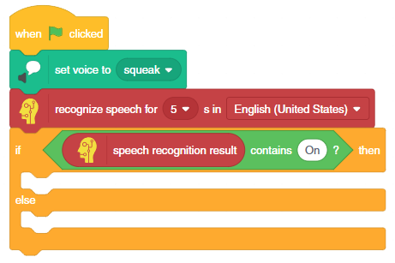
Let’s Code
Add the following code in your scripting area.
Step | Block | Palette
1. | when flag clicked | Events
2. | set voice to () | Text to Speech
3. | recognize speech for () s in () | Artificial Intelligence
4. | if () then | Text to Speech
5. | () contains on () | Operations
6. | speech recognition result | Artificial Intelligence

Slide 5
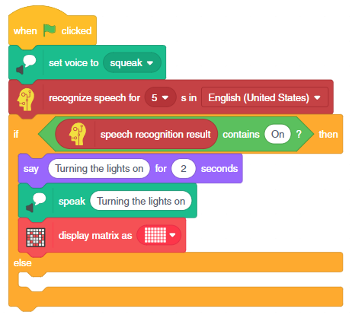
Let’s Code
Add the 3 blocks inside the if () then block of your script, as shown.
Step | Block | Palette
1. | say () for () seconds | Looks
2. | speak () | Text to Speech
3. | display matrix as () | Display
Add these 3 blocks

Slide 6
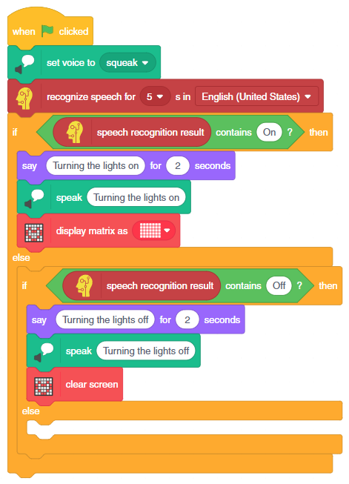
Let’s Code
Duplicate the if () then block, by right-clicking on it.
Drag this duplicated if () then block inside the else-arm of the original if () then block.
Change all the ‘on’ to ‘off’ within all the blocks in this duplicated if () then block.
Remove display matrix as () block and add clear screen block from the Display palette.
Duplicated block

Slide 7
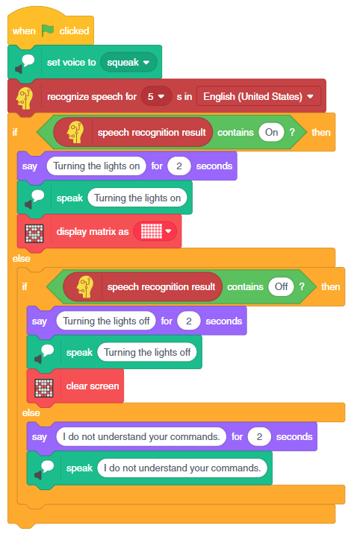
Let’s Code
Add the two blocks inside the last else-arm.
Also add the appropriate text.
Step | Block | Palette
1. | say () for () seconds | Looks
2. | speak () | Text to Speech
Add these

Slide 8
Run the Script

