Slide 1
Making a speech to text bot
Session 12

Slide 2
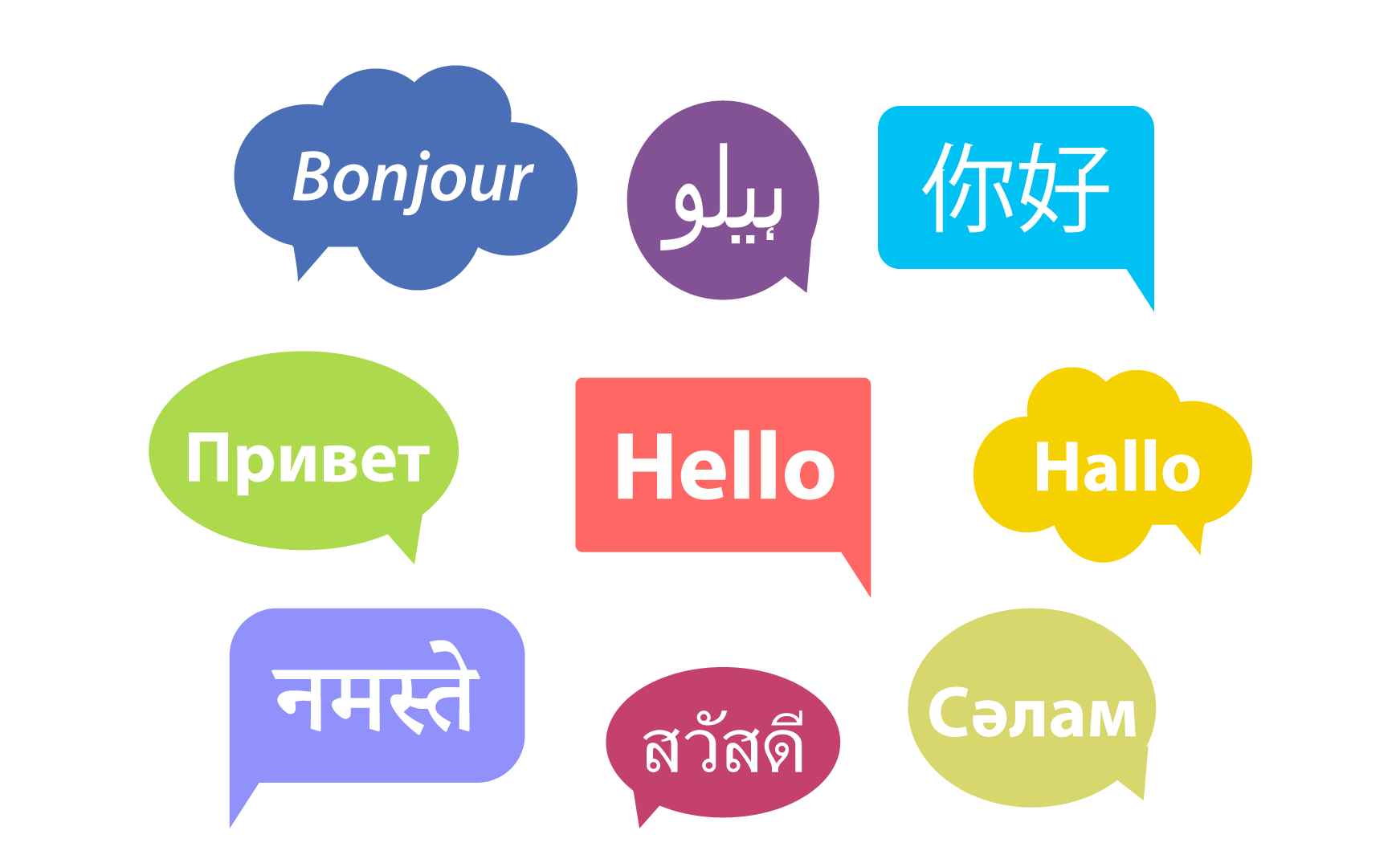
How do humans learn a language
Even before we can speak, we hear some words that we start responding to; like Mama, Dada, Yes, No.
Our brain tries to find patterns in various sounds and words we hear and tries to categorize them.
We need to be trained in order to develop this ability. Similarly, if we want computers to recognize various sounds and words, we need to train them.
Speech recognition technology has been developed on this very, principle.

Slide 3
Speech Recognition
Speech recognition is the ability of a machine to identify words and phrases in spoken language and convert them to a form that machines can understand (machine-readable format).
Let us build a bot that -:
  Recognizes human speech
  Converts it into machine-readable form
  Finally converts it into human readable text.

Slide 4
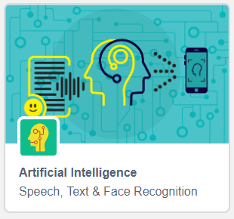
Speech-to-Text Blocks in PictoBlox
The Artificial Intelligence extension in PictoBlox has blocks dedicated to speech recognition. Hence let us add this extension first -:
Create a new project in PictoBlox.
Click on the Add Extension button and add the Artificial Intelligence extension.

Slide 5

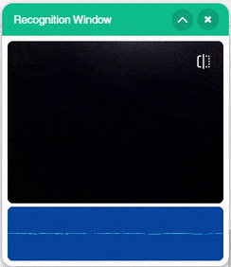
Speech Recognition Block
To execute speech recognition, we have the recognize speech for () s in () block in the Artificial Intelligence extension.
When this block is executed, a recognition window will open and you will get a specified time, ex: 2 seconds, (depending on what value you have specified in the block) during which PictoBlox will record whatever you say.
Once recorded, the speech will be converted to text. This text will be saved in your device.

Slide 6
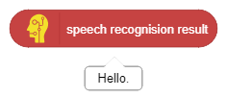
Speech Result Block
When you record your speech using the recognition window, it saves your speech as text. Now, you need to get this text back so that you can use it somewhere ex: to display it or speak it.
This can be done using the speech recognition result block. This block gives you back, the last text that it detected from the speech.

Slide 7
Making a speech to text bot
Let us make a script, that will record your voice command, analyze it and respond back to you.

Slide 8
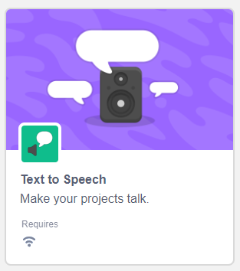
Adding the Text to Speech extension
First, let us add the Text to Speech extension in this project. This extension will translate the text recorded, to speech.
To add it, click the Add extension button and add the Text to Speech extension.

Slide 9
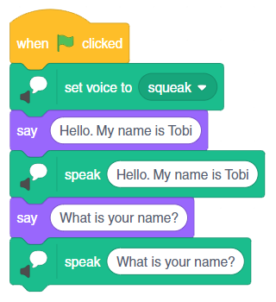
Let’s Code
Drag and drop the blocks in the scripting area as shown -:
Also fill the text area in the blocks, with appropriate text.
Step | Block | Palette
1. | when flag clicked | Events
2. | set voice to () | Text to Speech
3. | say () | Looks
4. | speak () | Text to Speech

Slide 10
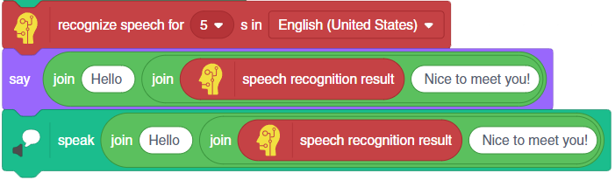
Let’s Code
Add the code shown below, to the script -:
Step | Block | Palette
1. | recognize speech for () s in () | Artificial Intelligence
2. | say () | Looks
3. | join () () | Operations
4. | speech recognition result | Artificial Intelligence
5. | speak() | Text to Speech

Slide 11
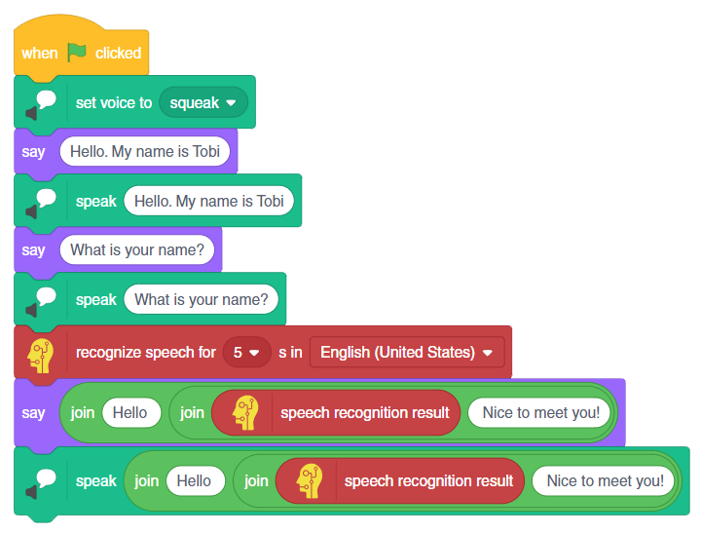
Final Script

Slide 12
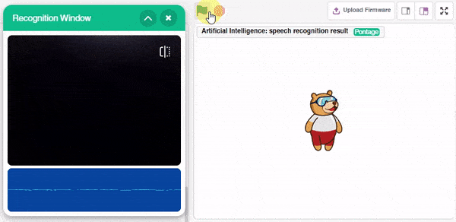
Run the final Script

